Slide 1
Federal Help for States to Combat Prescription Drug Abuse
NGA HHS Committee
January 2016

Slide 2
Overview
Federal focus: funding, flexibility, and other resources
Seven new programs in FYs 2015 and 2016
Prevention, treatment, monitoring, and enforcement
Administered by HHS and DOJ
Mostly discretionary, competitive
FY 2016 dedicated funding = $237 million
Includes $100 million for community health centers
S. 2423 proposes supplemental funding

Slide 3
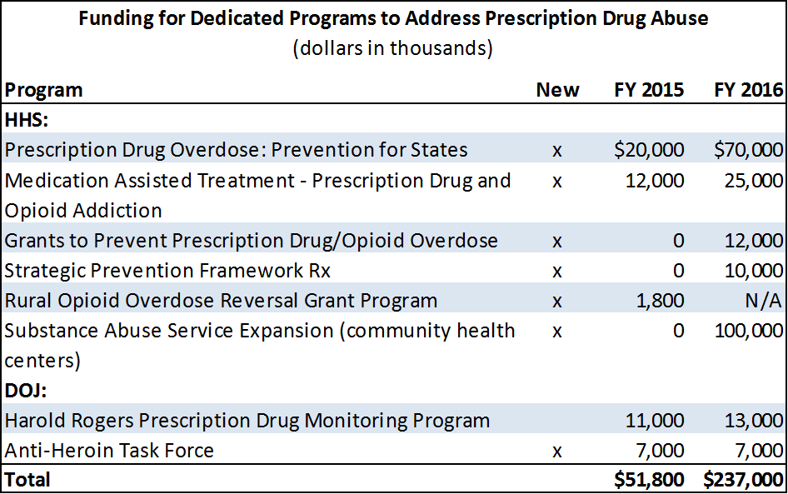
What are the major programs?

Slide 4
How can funds be used?

Slide 5
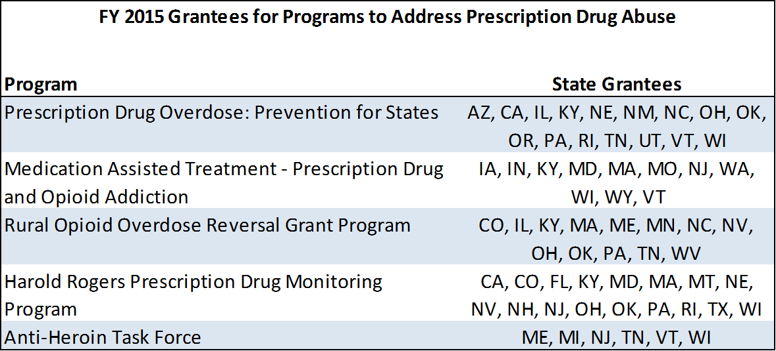
State grantees

Slide 6
What about other programs?
Substance Abuse Prevention and Treatment Block Grant ($1.9 billion)
Purchase naloxone; support prevention, education, and training
Medicaid
Section 1115 demonstration
Edward Byrne Memorial Justice Assistance Grants ($347 million)
Drug treatment, enforcement
Second Chance Act ($68 million)
Medication-assisted treatment

Slide 7
Issues to watch
FY 2016 funding opportunities on www.grants.gov
Additional funding
S. 2423 provides supplemental FY 2016 funds
President’s FY 2017 budget
Other legislation
National All Schedules Prescription Electronic Reporting Reauthorization (H.R. 1725)
Comprehensive Addiction and Recovery Act

Slide 8
S. 2423 would provide new funding

Slide 9
Questions?
Check for updates at www.ffis.org
Trinity Tomsic, ttomsic@ffis.org, 202-624-8577

