Slide 1
Since Last We Met
NASBO Spring Meeting
New Orleans, LA
March 31, 2016

Slide 2
2015 went out with a bang
Bipartisan Budget Act of 2015 (BBA; November)
  Debt limit suspended until March 2017
December was busy!
  FY 2016 omnibus appropriations
  Every Student Succeeds Act (FY 2017-2020)
  FAST Act (FY 2016-2020)
President’s budget (February)
  Followed by congressional decisions and indecision

Slide 3
Key features of the BBA

Slide 4
BBA paved way for FY 2016 omnibus

Slide 5
Key features of ESSA
More state flexibility; fewer federal prescriptions
SIGs absorbed by Title I
Phased-in change to Title II formula (Supporting Effective Instruction)
One large new formula program
  Student Support and Academic Enrichment Grant (~$1.6B authorization)
Some smaller new competitive grants
  Preschool Development Grants ($250M)

Slide 6
Key features of FAST Act

Slide 7
Key features of FAST Act, continued

Slide 8
Onto FY 2017 budget cycle
President released budget in February
Senate will forego a budget resolution in favor of top-line spending specified in the BBA
House is wedged between a rock and a hard place

Slide 9
Key features of president’s budget
Complies with BBA, in fact if not in spirit:
Adds billions in mandatory spending, outside of caps (not shown).

Slide 10
Key features of the congressional debate
The Senate can live with the BBA
The House, not so much:
  Deficit hawks: cut $30 billion to reverse BBA increase for FY 2017
  Defense hawks and moderates: live with current caps and look for alternatives to reduce future mandatory spending

Slide 11
The proposed solution
House budget resolution adheres to BBA discretionary caps
Includes reconciliation instructions to achieve $30 billion in mandatory savings over two years
  Cuts to SSBG, Medicaid, CHIP already approved at committee level
  SNAP block grant possible

Slide 12
The proposed solution, continued

Slide 13
Why the gambit isn’t working
If Senate doesn’t adopt a budget resolution, there will be no reconciliation process, and no cuts to mandatory programs
But discretionary spending bills will move along through regular appropriations process
Using current recess to sort things out

Slide 14
In the absence of agreement
There will be no concurrent budget resolution
House and Senate will deem their individual resolutions to be binding
  House may even skip the deeming
Appropriations work will proceed on separate tracks, possibly with separate top-line totals
Will make conferencing difficult

Slide 15
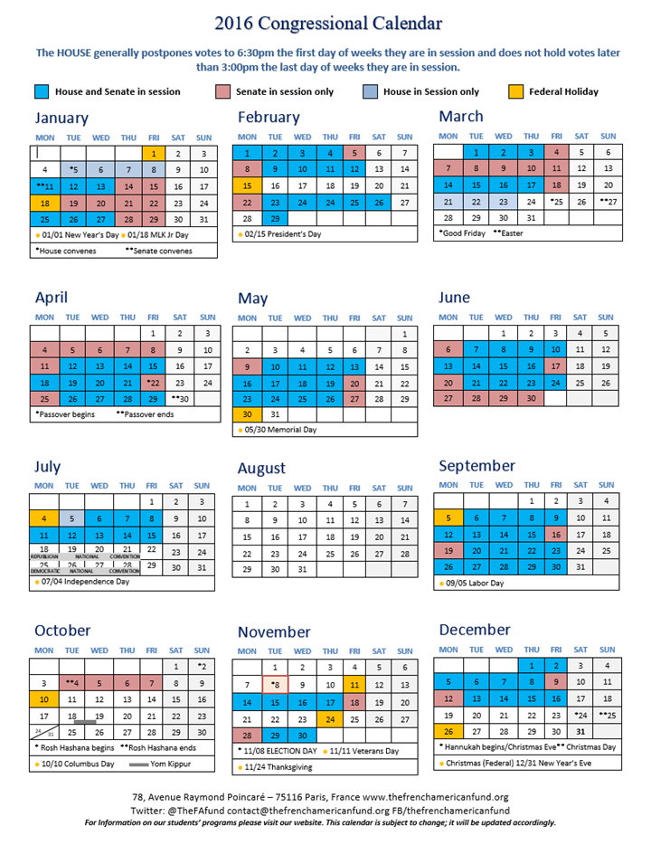
The calendar plays a role

Slide 16
Speculating about an end-game
Already talk of a lame duck session
  Supreme Court nomination
Political calculus in deciding where to leave things before November elections
Likelihood of a CR on October 1 is very high
A lame-duck omnibus is also likely

Slide 17
FFIS resources
BBA: Budget Brief 15-09
2016 appropriations:
  Jim Martin Table
  Budget Brief 15-10
ESSA: Issue Brief 15-40
FAST Act: Issue Brief 15-39
PB 2017:
  Jim Martin Table
  Budget Brief 16-01
FFIS grants database

Slide 18
Questions?
Check for updates at www.ffis.org
  mhoward@ffis.org; 202-624-5848

