Slide 1
Federal Funding Update: We Live in Interesting Times
Maryland Senate Budget and Taxation Committee
January 28, 2015
Federal Funds Information for States
www.ffis.org

Slide 2
Big Questions
How does FY 2015 budget play out?
Is there any hope for common ground?
FY 2016 appropriations
Budget Control Act (BCA)
Expiring programs
Tax reform
Debt limit

Slide 3
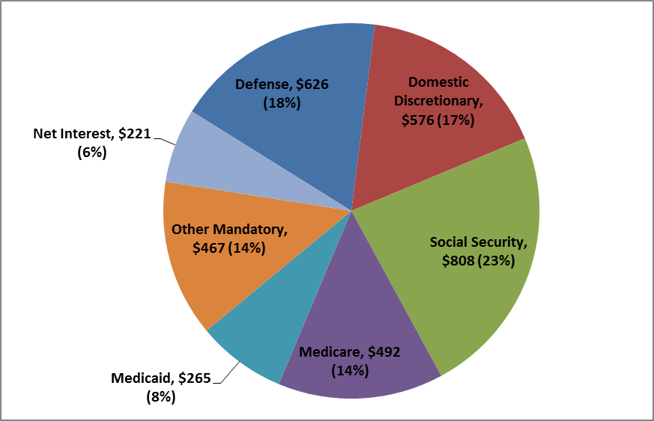
But first, the basics
Composition of Federal Outlays in FY 2013 ($ in Billions, % of Total)

Slide 4
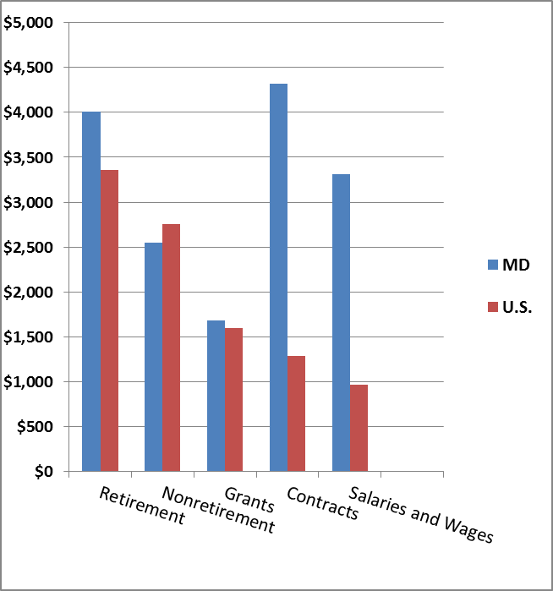
Per capita federal spending flowing to Maryland, FY 2013
Source: Pew Charitable Trusts

Slide 5
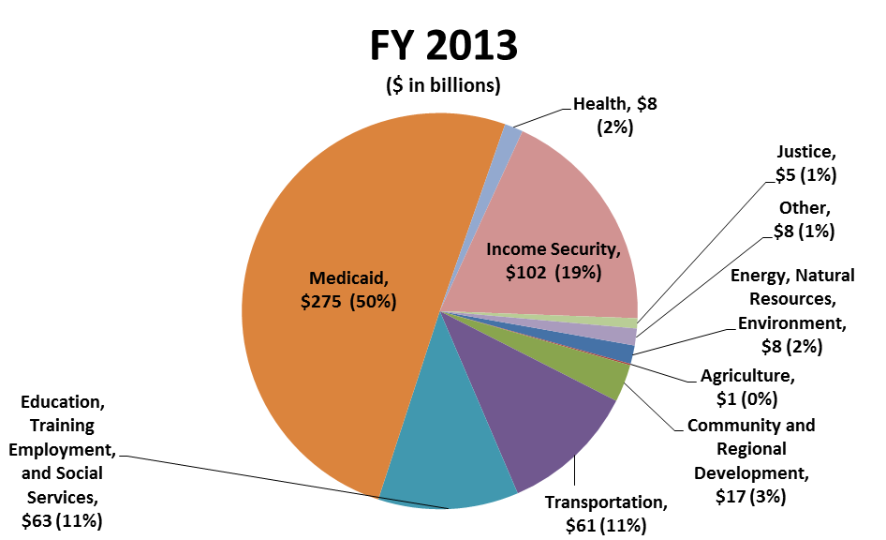
What program areas are supported by federal grants to state/local gov’t?

Slide 6
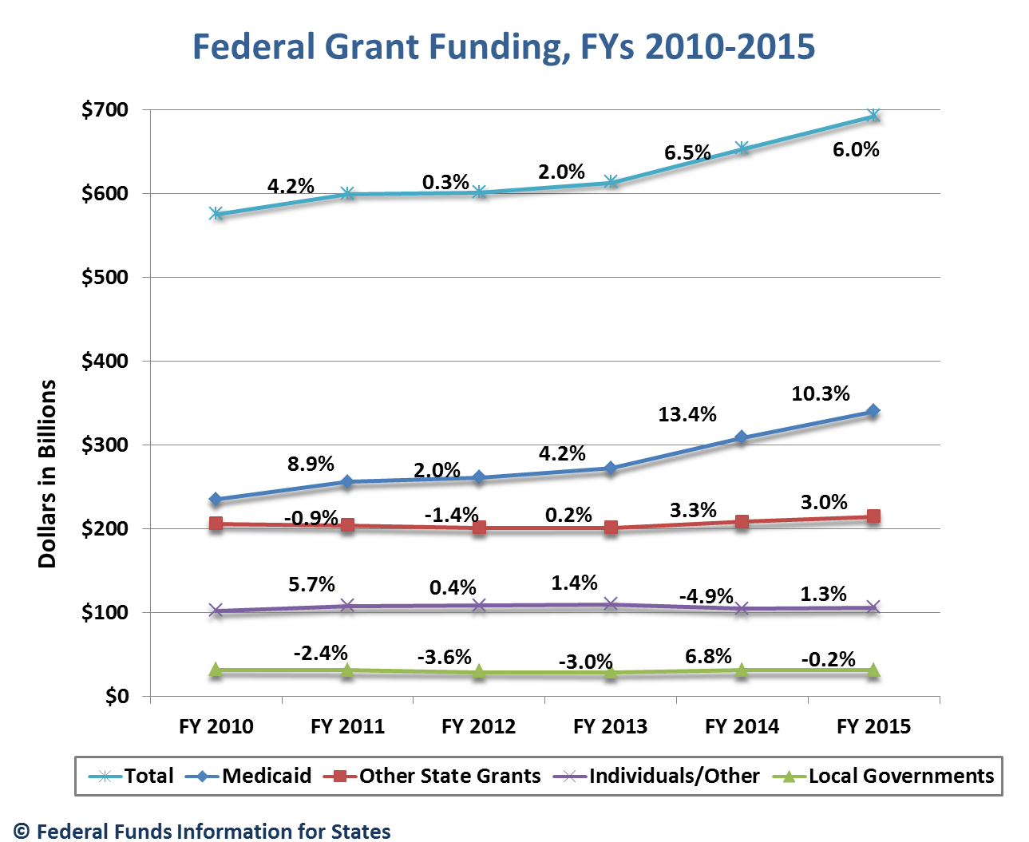
Recent trends in grant funding

Slide 7
Per capita federal spending on selected grants, FY 2013

Slide 8
Federal grants going to Maryland: per capita, FY 2013
Major Category | U.S. Average Per Capita | Maryland Per Capita | Maryland Rank
Medicaid | $852 | $695 | 36
Other State | 587 | 486 | 48
Local | 88 | 80 | 24
Individual/Other | 344 | 279 | 38
Total | $1,871 | $1,540 | 42

Slide 9
Conflicts on the horizon
FY 2015 Homeland Security/immigration
FY 2016 budget; amending BCA
Deficit reduction
Tax reform
Federal workforce
Debt limit
Highway Trust Fund solvency
Expiring programs

Slide 10
The BCA is the law of the land
Discretionary sequestration persists in form of lower caps
Mandatory sequestration still occurs
Bipartisan Budget Act (BBA) extended it to FY 2023
Repeal unlikely
ATB percentages applied to current-law levels
 | Defense | Nondefense
FY 2014 | -9.8% | -7.2%
FY 2015 | -9.5% | -7.3%

Slide 11
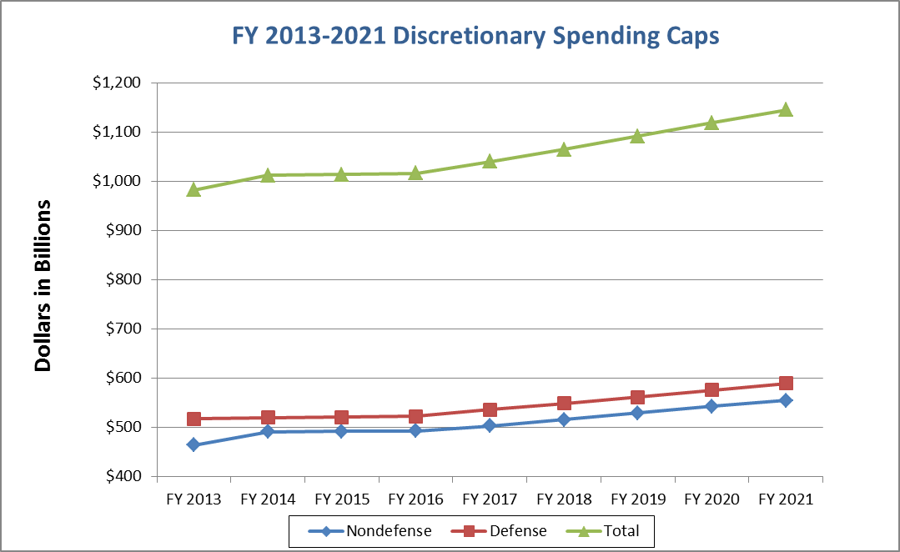
The BCA going forward

Slide 12
BCA projections

Slide 13
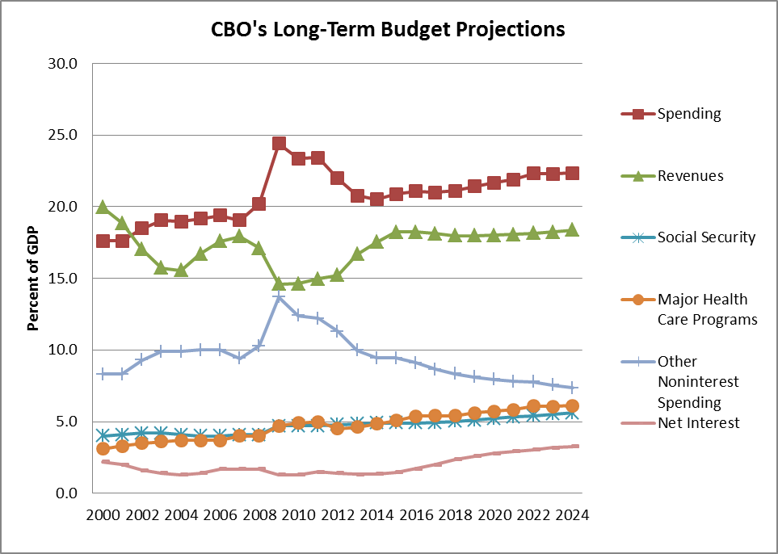
Implications of the BCA
Source: CBO Budget and Economic Outlook, 2/14

Slide 14
Expiring programs in an uncertain environment
Programs covering all major areas expire in 2015
Most are mandatory-funded programs
Require congressional action
Some have been operating under short-term extensions for years
ACA programs at greatest risk

Slide 15
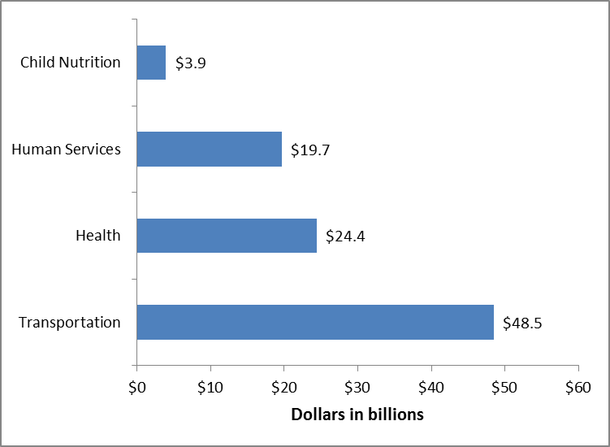
National funding at stake

Slide 16
Recent and upcoming deadlines
October 1, 2014
Mandatory sequestration
Medicaid primary care increase expired
February 27, 2015
FY 2015 CR for Homeland Security expires
January 1, 2015
No new exchange grants
Health insurance rate review, ADRCs, College Access Challenge grants expired
Tax extenders expired

Slide 17
Recent and upcoming deadlines
March 15, 2015
Debt limit reinstated
April 1, 2015
Qualifying Individual, Transitional Medical Assistance, Early Childhood Home Visiting and others expire
June 1, 2015
Highway Trust Fund (HTF) projected to become insolvent
Surface transportation programs expire

Slide 18
Recent and upcoming deadlines
July 1, 2015
Import-Export Bank expires
October 1, 2015
TANF and related programs expire
No new allotments for CHIP
Many ACA programs expire
Airport improvement program expires
Some child nutrition programs expire
Internet tax moratorium expires

Slide 19
More questions than answers
Will it be total gridlock and if so, how will it affect states?
Budget resolution
BCA
Deficit reduction
Tax reform
Program extensions
ACA
Debt limit increase

Slide 20
Questions?
For more information: www.ffis.org,
Trinity Tomsic (ttomsic@ffis.org )

