Slide 1
The IDEA Behind Full Funding for Federal Special Education Programs
Federal Funds Information for States www.ffis.org
March 2015

Slide 2
IDEA at a Glance
What is IDEA?
Major changes over time
Appropriated vs. estimated full funding
Reauthorization

Slide 3
What is IDEA?
Individuals with Disabilities Education Act (P.L. 101-476)
First enacted in 1975 (P.L. 94-142)
Created Grants to States for Education of Children with Disabilities (CFDA # 84.027)
Committed funding 40% of the national Average Per Pupil Expenditure (APPE) multiplied by the number of children in special education
Did NOT commit mandatory funding

Slide 4
Most Recent Authorization
Individuals with Disabilities Education Improvement Act (P.L. 108-446)
Specified authorized levels from FY 2005 to FY 2011, thereafter “such sums as necessary”
Modified formula:
40% of APPE * Special-Ed Students in 2004-2005
Adjusted by
Annual changes in state population of school-age children (85% of the adjustment)
Those in that same age range living in poverty (15% of the adjustment)

Slide 5
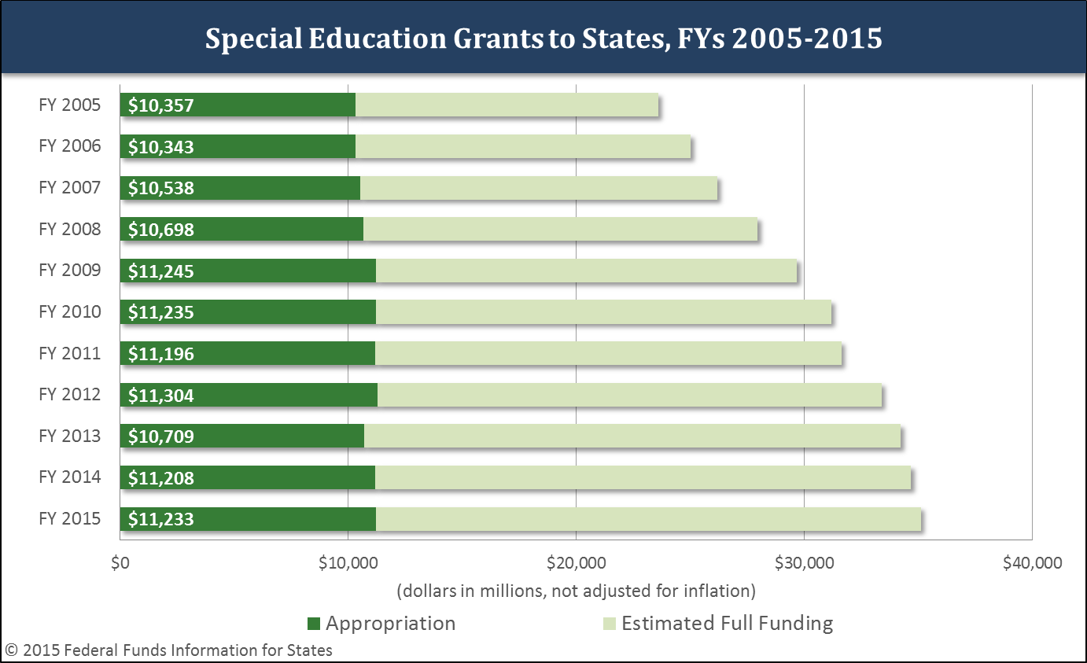
Full Funding Estimates vs. Appropriations
State-by-state detail available in Issue Brief 14-31

Slide 6
Example of Funding Shortfall

Slide 7
Reauthorization Proposals
Discretionary vs. mandatory designation
Full funding levels
Covering costs of expert fees and examinations for lawsuits against schools

Slide 8
H.R. 551
IDEA Full Funding Act (H.R. 551)
Authorizes and appropriates amounts approaching full funding by FY 2025
Return to classic formula:
40% of National APPE * number of special education students receiving services in the state between the ages of 3-21 during the school year ending before the previous fiscal year
Requires PAYGO offsets

Slide 9
S. 130
IDEA Full Funding Act (S. 130)
Program authorized as a percentage of maximum amount of grants, approaching 100% by FY 2025
Appropriates amounts equal to the difference of the authorization less $11.5 billion
Uses current formula
No PAYGO requirement mentioned

Slide 10
Questions?
For more information: www.ffis.org Nick Jacobs (njacobs@ffis.org)

