Slide 1
A Primer on Federal Grants: How They Work and Why It Matters
Marcia Howard
mhoward@ffis.org
Federal Funds Information for States www.ffis.org
Notes:
How the federal government spends its funds; relationship between federal government and states
Characteristics of federal grants, federal grants process (how it is suppose to work, how it works)
Trends and challenges

Slide 2
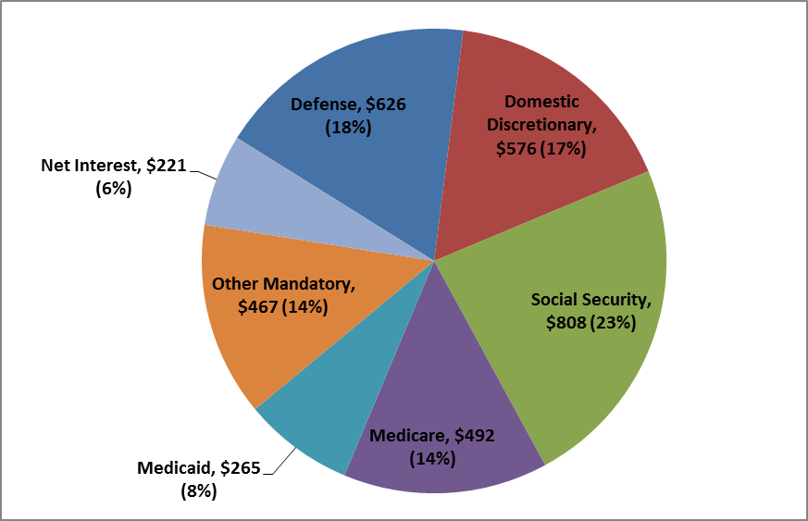
Where the money goes: pieces of the federal budget pie
Composition of Federal Outlays in FY 2013 ($ in Billions, % of Total)

Slide 3
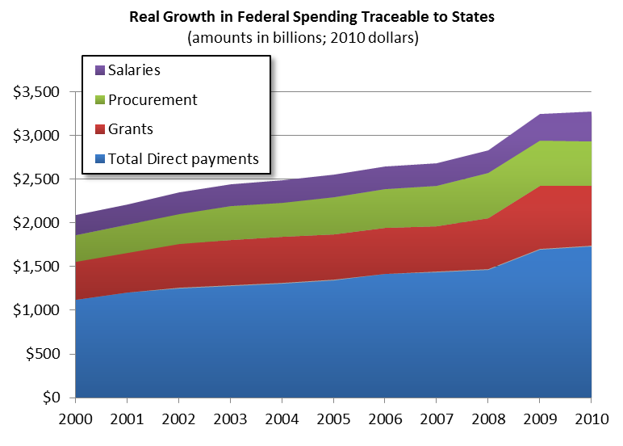
Flow of federal funds traceable to states
Notes:
Census report – tracks flow of all federal funds by states; states use to assess fiscal relationship w/federal gov’t
Very relevant in era of budgets; report was victim of spending reductions
Direct payments: payments provided directly to individuals (Social Security, Unemployment, Medicare, Retirement/Disability)
Procurement: reflects where the federal government purchases goods/services (defense-related equipment production centers)
Federal grants: 1,714 federal grants
Salaries and wages: federal employees (federal offices/military installations)
Procurement grown fastest – increase emphasis on competitive contracting/spending on wars

Slide 4
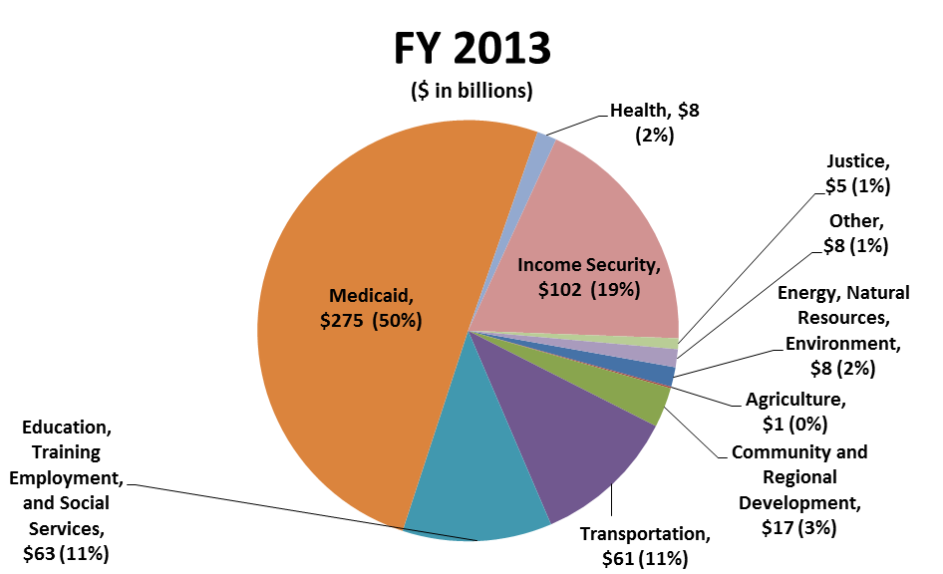
What programs areas are supported by state/local grants?

Slide 5
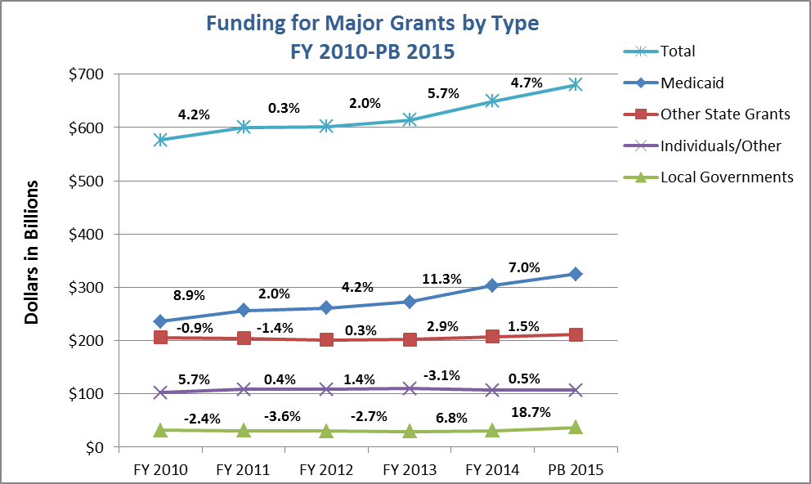
Recent trends in grant funding
Source: FFIS Grants Database

Slide 6
Types of Grants
Mandatory
Capped
Uncapped
Discretionary
Block Grant
Categorical Grant
Formula Grant
Formula Grant
Project Grant
Direct Appropriation
Annual Appropriation
Notes:
Biggest difference: Mandatory spending dictated in authorizing legislation; Discretionary spending determined by annual appropriations process
Mandatory: specific funding level in authorizing legislation or eligibility/benefit criteria w/spending increasing/decreasing based on need
Some mandatory grants bypass the appropriations process altogether; other programs rely on authorization legislation to determine the funding level, but the funding is included in annual appropriations bills.
Discretionary: Differ in federal control (block grants most flexible, then formula, then project) and how the federal government allocates funding

Slide 7
What is the difference between mandatory and discretionary spending?
Mandatory Spending
Funding level isn’t determined by annual appropriations
Funding level dictated in authorizing legislation
Requires current authorization
Discretionary Spending
Funding level determined through annual appropriations process
Current authorization not required for funding

Slide 8
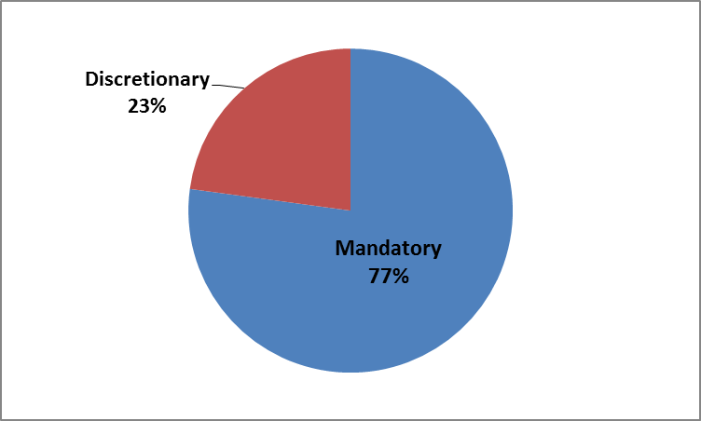
Mandatory vs. discretionary funding to states

Slide 9
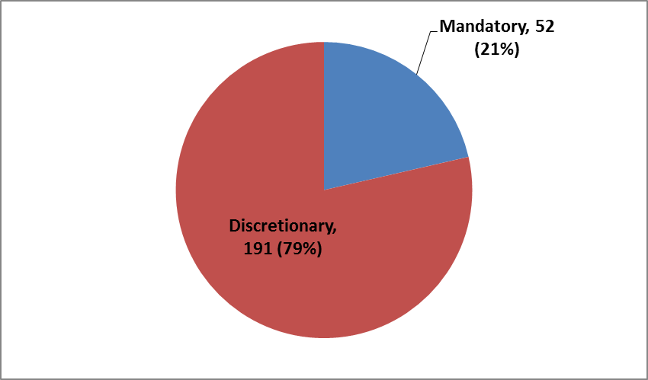
Mandatory vs. discretionary grants to states

Slide 10
How do discretionary programs work?
Two-step process to receive funding
Program is created through enactment of authorizing legislation
Specifies maximum amount or “such sums as may be necessary”
Program funded through appropriations process
Some authorized programs not funded
Many programs funded but lack current authorization
Examples: Child Care Development Block Grant , Community Development Block Grant, elementary and secondary education programs, LIHEAP
Notes:
Authorizing legislation – define program objects; provide some detail (agencies fill in the rest through regulations)
Can specify maximum for one year, then such sums as necessary
Appropriations process provides budget authority to carry out programs (rare for programs to be funded at max, sometimes exceed (CCDBG))
Budget process not complete by October 1: CR; suppose to consider 12 appropriations measures individually; minibus, omnibus, or full-year CR
CCDBG (2002), CDBG (1994), NCLB (2007), LIHEAP (2007); appropriations process can include new program, formula changes, set-asides, agency directives
Examples: Senate proposing new 5% set-aside for MHBG for evidence based programs for indiv. w/early signs of serious mental illness
Rules to maintain separation; must be point of order and rules can be waived
CCDBG – new $ for improving quality of childcare
LIHEAP – Formula change (allocate more funds based on old formula)

Slide 11
What are the major types of discretionary grants?
Block Grants: fixed funding for general purposes, allocated to states by formula
Categorical Grants: specific, narrowly defined purpose
Formula grants
Noncompetitive awards based on predetermined formula
Amount allocated depends on various factors (i.e., population, per capita income, small-state minimum)
Project grants
Generally awarded through a competitive process
Fixed project periods/delivery of specific services
Cooperative agreement (substantial federal involvement)
Notes:
Conditions/requirements attached to all grants but varying degrees of flexibility
Block grants – state/local governments have more flexibility; funds can be used on a range of activities (Congress has reduced flexibility over time)
22 block grants; 10 HHS (two mandatory)
Definition of block grant: eligibility limited to s/l gov’t, formula, funds may be used within broad categories
Categorical grants: Narrowly defined purpose such as providing nutrition to the elderly. Authorizing legislation specifies types of activities that can be funded; more federal requirements/monitoring
Formula grants: historical distribution or demographics/other factors related to grant (population, poverty levels); can have minimum allocations
Categorical formula grants generally more flexible than project grants (federal rules specify types of projects, s/l gov’t determine specific projects to fund)
Project grants: federal government chooses projects to fund; used competitive process to increase innovation

Slide 12
Other major features of discretionary grants
State contribution
Matching, maintenance-of-effort (MOE) requirements
Supplantation provisions
Flexibility
Transfer authority
Program requirements
Funding availability
Obligation, liquidation deadlines
Carryover authority

Slide 13
Discretionary: Example Programs
 | Block Grant | Categorical
Program | Formula | Formula | Project | Matching
National Highway Performance Program |  | X |  | X
Title I - Local Education Agencies |  | X |  | X (MOE)
Special Education Basic State Grant |  | X |  | X (MOE)
FHWA - Surface Transportation Program |  | X |  | X
Head Start |  | X | X | X
WIC - Supplemental Feeding Program |  | X
FTA - Urbanized Area Formula |  | X |  | X
Public Housing Operating Fund |  | X
Consolidated Health Centers Disc. |  |  | X | X
Low Income Home Energy Assistance | X
Airport Improvement Program |  | X |  | X
UI State Administration Base Allocation |  | X
Child Care & Devel. Block Grant | X

Slide 14
How do mandatory programs work?
Most mandatory spending is in the form of “entitlement” spending
Federal government legally obligated to make payments to eligible entities
Uncapped entitlements: Total spending is determined by number of eligible beneficiaries and authorized benefit payments (Medicaid, SNAP)
Capped entitlements: Spending capped at specific level provided in authorizing law (SSBG, CHIP)
Examples of other mandatory spending
Some funding included in health care reform

Slide 15
How do mandatory programs work?
Mandatory programs are funded by either direct appropriations in authorizing law or annual appropriations
Most mandatory spending bypasses the appropriations process altogether
Mandatory spending included in annual appropriations acts is determined by authorizing statute
Some mandatory programs are block grants
Similar features as discretionary programs
State contribution, flexibility, funding availability

Slide 16
How do mandatory programs work?
Legislative changes to entitlement spending can be done through authorizing bills or reconciliation, but not through appropriations process
Reconciliation instructions are included in the budget resolution and considered under special procedures
Various statutory/procedural controls on entitlement spending
Additional mandatory spending must be offset
Notes:
Budget resolution framework for budget legislation (projected spending includes mandatory), may also include reconciliation directives instructing H/S authorizing committees to recommend changes to mandatory programs to meet certain recommend levels of spending (increases or decreases). (Committees not bound by suggestions or assumptions; committee may vote to favorable or unfavorably support language)
Consideration under special procedures: House (limits on debate/amendments); Senate (amendments must be germane, limits on debate and thus defuses filibuster; Byrd rule – must directly affect federal spending, cannot violate reconciliation instructions, within committee’s jurisdiction) Examples: CHIP, Welfare Reform, Major Tax Cuts, Reconcile H/S differences over HCR
Normal legislative process: not before budget resolution adopted (can’t exceed spending allocation included in budget resolution)
Procedural controls: House CUTGO: can’t have net effect of increasing mandatory spending, offset by mandatory cuts; Senate PAYGO similar but offset may include revenue increases (point of order procedural mechanism for enforcement; can be waived)
Statutory controls: PAYGO (legislation affecting mandatory spending and revenues can’t increase deficit over a specified period), enforced by sequestration (nonexempt direct spending programs)

Slide 17
Mandatory: Example Programs
Program | Capped | Uncapped | Block Grant | Set Period | Appropriated | Matching MOE
Medicaid |  | X |  |  | X | X
CHIP | X |  |  | X |  | X
TANF | X |  | X | X |  | X (MOE)
Child Nutrition - School Lunch |  | X |  | X | X | X
SNAP State Administration |  | X |  | X | X | X
Foster Care/Adoption |  | X |  |  | X | X
Child Supp. Enforcement Admin. |  | X |  |  | X | X
Child Nutrition - School Breakfast |  | X |  | X | X
Vaccines for Children |  | X |  |  | X
CN - Adult & Child Care Food |  | X |  | X | X
Rehab. Services - Basic State |  | X |  | X | X | X (BOTH)
Child Care Entitlement | X |  |  | X |  | X (BOTH)

Slide 18
Why does the type of funding matter?
Frequency of congressional action to determine funding levels
Discretionary (annual); mandatory (varies)
Timing of reauthorization/extension
Mandatory programs require an authorization to operate; discretionary programs can continue without an authorization.
BCA sequestration
Different process for mandatory/discretionary programs
Most mandatory programs exempt
Government shutdown
Some mandatory programs can continue to receive funding

Slide 19
Current issues and themes dominating federal grants
Congressional failure to reauthorize
Increased reliance on appropriations process to modify
Introduction of competitive elements to current and proposed grants
Increased focus on transparency, program outcomes, program integrity
Trend toward program consolidation

Slide 20
Useful grant resources
GAO glossary of budget terms: http://www.gao.gov/new.items/d05734sp.pdf
FFIS links: http://www.ffis.org/node/3160
Congressional Research Service (CRS) Reports
Federal Grants-in-Aid Administration: A primer http://www.fas.org/sgp/crs/misc/R42769.pdf
Entitlements and Appropriated Entitlements http://www.fas.org/sgp/crs/misc/RS20129.pdf
Introduction to the Federal Budget Process http://www.fas.org/sgp/crs/misc/98-721.pdf
Catalog of Federal Domestic Assistance (CFDA.gov)
Funding announcements (grants.gov)

Slide 21
The End: Questions?

