Slide 1
The BCA in FY 2014 and Beyond
NASBO Annual Meeting
Anchorage, AK
July 23, 2013
Federal Funds Information for States
www.ffis.org

Slide 2
How did we get here?

Slide 3
The BCA in a nutshell
Discretionary spending caps w/adjustments
Joint Select Committee on Deficit Reduction (to address mandatory spending and revenues)
Sequestration process (as fallback)

Slide 4
The federal budget in a nutshell (FY 2012, $ in billions)

Slide 5
How sequestration works
$984 billion in cuts through FY 2021 (~$109 billion/year, half from defense, half from nondefense)
FY 2013 sequestration occurred on March 1, 2013
“Fix” reduced cuts from $109b to $85b
Many mandatory and a few discretionary programs are exempt (special rules for some programs)
ATB cuts in FY 2013, different process for FY 2014+

Slide 6
How sequestration was implemented in FY 2013
ATB cuts: -5.0% for nondefense discretionary, -5.1% for nondefense mandatory, -7.8% for defense
Applied to FY 2013 funding in place on 3/1/13
Cuts were applied to each program, project and activity (interpretation varied by agency)
Final 2013 appropriation levels and existing agency flexibility mitigated or worsened effects of sequester in some instances
Cuts reflected in grant awards issued after March 1, 2013
Timing varied by program

Slide 7
Sequestration in FY 2013 vs. FY 2014
 | FY 2013 | FY 2014
Mandatory | ATB (-5.1%) | ATB (-7.2% est.)
Program Exemptions | Yes | Yes
Effective Date | March 1, 2013 | October 1, 2013
Flexibility | PPA | PPA
Discretionary | ATB (-5.0%) | Lower Caps
Program Exemptions | Yes | No
Effective Date | March 1, 2013 | October 1, 2013
Flexibility | PPA | Appropriation Account
Enforcement | N/A | Same as FY 2013

Slide 8
House and Senate take divergent paths in FY 2014, neither of which conforms to BCA

Slide 9
Divergent paths lead to different outcomes for states

Slide 10
Progress of a sort has been made

Slide 11
How do major grant programs fare?
 | ($ in millions) | ($ in millions) | Proposed FY 2014 vs. FY 2013
Federal Agency | FY 2012 | FY 2013 | President | House | Senate
Agriculture | $6,861 | $6,766 | 9.6% | 2.3% | 8.5%
Education | 37,273 | 35,341 | 8.7% | n/a | 6.0%
Health and Human Services | 25,180 | 24,127 | 9.6% | n/a | 13.5%
HUD | 40,812 | 39,421 | 11.5% | -0.9% | 12.2%
Energy/EPA | 63,183 | 63,288 | 1.5% | -8.2% | 1.9%
Justice | 1,251 | 1,221 | 4.6% | -13.0% | -2.1%
Homeland Security | 1,254 | 1,359 | 9.9% | 28.4% | 8.7%
Labor | 6,579 | 6,176 | 4.3% | n/a | 3.5%
Transportation | 54,098 | 54,532 | 0.9% | 1.4% | 1.7%

Slide 12
What are congressional priorities?
Must Do | Things to Watch
Enact a budget for FY 2014 | Immigration reform
Reauthorize or extend Farm Bill | ESEA reauthorization
Reauthorize or extend TANF | WIA reauthorization
Raise debt limit | DATA Act
 | Early Childhood Education

Slide 13
The BCA becomes less restrictive going forward

Slide 14
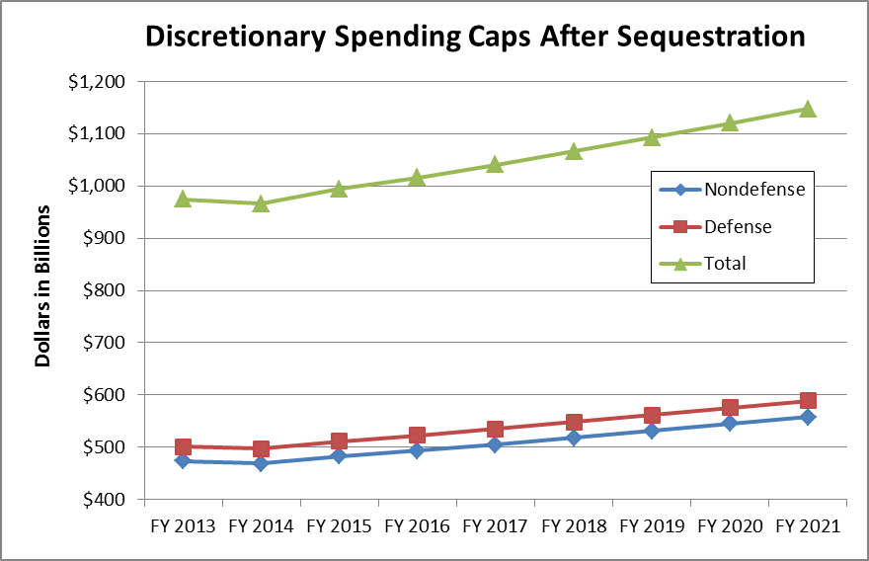
Discretionary spending grows after FY 2014, even with sequestration

Slide 15
Questions, Comments, Difficulties
The House and Senate are proceeding based on their own budget resolutions, which are vastly different from one another.
How and when will the gaps be bridged?
Will FY 2014 begin with a CR?
“Action-forcing” event: raising the debt ceiling.
After FY 2014, discretionary spending increases under the BCA, even with sequestration.

