Slide 1
Federal Funding Update: The Craziest Year Yet
HSFO Annual Conference
September 17, 2012
Federal Funds Information for States

Slide 2
Overview
The Federal Budget Problem
Congressional “To Do” List
Before: End of the fiscal year (9/30/12)
After: The November election (11/7/12)
What Does it Mean for States?

Slide 3
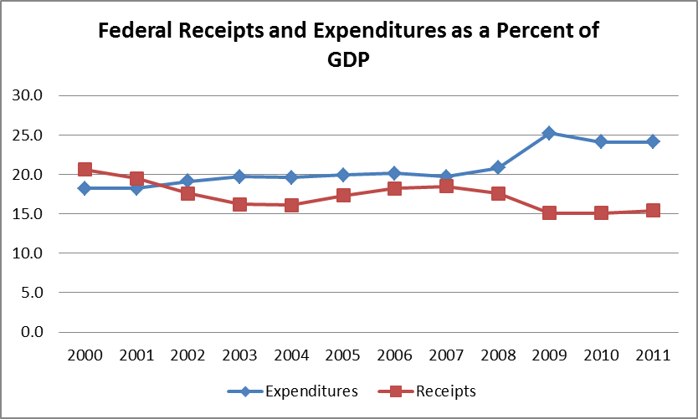
The Federal Budget Problem

Slide 4
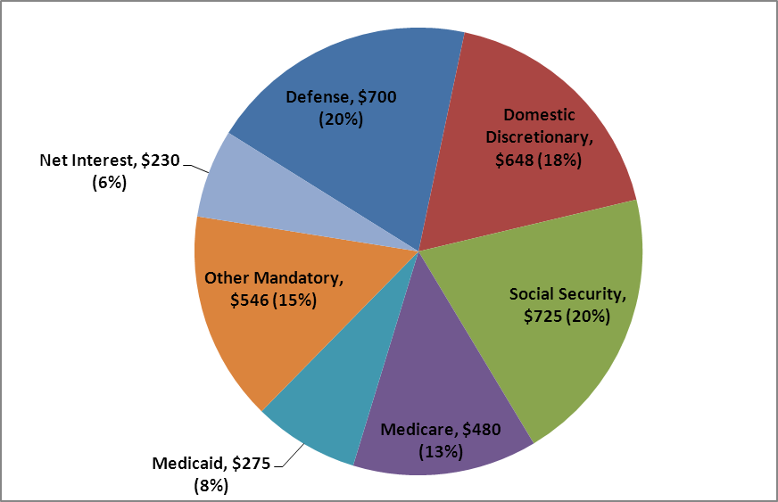
Where the Money Goes: Pieces of the Federal Budget Pie
Composition of Federal Outlays in FY 2011 ($ in Billions, % of Total)

Slide 5
“Must Do” List before Sept. 30, 2012
Enact FY 2013 budget or pass a Continuing Resolution (CR)
Authorize or extend Farm Bill
Authorize or extend TANF

Slide 6
FY 2013 Appropriations: A $19 Billion Difference
FY 2013 302(b) Allocations
(in billions)
 | FY 2013 Funding Levels |  |  | Senate v. House
Appropriations Bills | House | Senate |  | Dollars | Percent
Agriculture | $19.4 | $20.8 |  | $1.4 | 6.6%
Commerce-Justice-Science | 51.1 | 51.9 |  | 0.7 | 1.4%
Defense | 519.2 | 511.2 |  | -8.1 | -1.6%
Energy-Water Development | 32.1 | 33.4 |  | 1.3 | 3.8%
Financial Services-General Government | 21.2 | 23.0 |  | 1.8 | 8.0%
Homeland Security | 39.1 | 39.5 |  | 0.4 | 1.0%
Interior-Environment | 28.0 | 29.7 |  | 1.7 | 5.6%
Labor-Health and Human Services-Education | 150.0 | 157.7 |  | 7.7 | 4.9%
Legislative Branch | 4.3 | 4.4 |  | 0.1 | 3.0%
Military Construction-Veterans Affairs | 71.7 | 72.2 |  | 0.5 | 0.7%
State-Foreign Operations | 40.1 | 49.8 |  | 9.7 | 19.5%
Transportation-Housing and Urban Development | 51.6 | 53.4 |  | 1.8 | 3.4%
Total Discretionary Spending | $1,027.9 | $1,047.0 |  | $19.1 | 1.8%

Slide 7
Status of FY 2013 Appropriations

Slide 8
FY 2013 Appropriations: At What Cost to States?
 |  | Proposed FY 2013 vs. FY 2012
Federal Agency | FY 2012 vs. FY 2010 | President | House | Senate
Education | -1.1% | 1.3% | n/a | 0.5%
Health and Human Services | -5.6% | -1.9% | n/a | 1.2%
Housing and Urban Development | -5.4% | 1.7% | 2.4% | 5.2%
Energy/EPA | -33.2% | -11.6% | -36.2% | n/a
Justice | -40.9% | -1.5% | -6.0% | 6.9%
Homeland Security | -35.4% | 29.4% | 27.2% | 3.5%
Labor | -4.9% | -2.2% | n/a | -2.9%
Transportation | -9.0% | 6.8% | -0.3% | 0.3%

Slide 9
Funding Levels for Major Health and Human Services Programs (in millions)
 |  |  | Proposed FY 2013 vs. FY 2012
Program | FY 2010 | FY 2012 | President | House | Senate
Substance Abuse Block Grant | $1,799 | $1,800 | -0.4% | NA | 1.1%
Mental Health Block Grant | 421 | 460 | 0.0% | NA | 4.3%
Maternal & Child Health Block Grant | 662 | 639 | 0.2% | NA | 0.2%
Community Health Centers | 2,190 | 1,567 | -0.3% | 0.0% | 0.0%
Preventive Health Block Grant | 102 | 80 | -100.0% | 25.2% | 0.2%
Family Planning | 317 | 294 | 1.0% | -100.0% | 0.0%
Ryan White AIDS Grants | 2,291 | 2,392 | 3.3% | -2.0% | 1.3%
Hospital Preparedness | 420 | 375 | -32.0% | NA | -13.3%

Slide 10
Funding Levels for Major Health and Human Services Programs (in millions)
 |  |  | Proposed FY 2013 vs. FY 2012
Program | FY 2010 | FY 2012 | President | House | Senate
CDC-State & Local Capacity (Bioterrorism) | $761 | $657 | -2.3% | NA | 0.0%
Head Start | 7,235 | 7,969 | 1.1% | 0.6% | 0.9%
Child Welfare Services | 282 | 281 | 0.1% | NA | 0.1%
Community Services Block Grant | 700 | 677 | -48.3% | -0.1% | -0.1%
Child Care & Development Block Grant | 2,127 | 2,278 | 14.3% | 1.1% | 7.0%
Low-Income Home Energy Assistance | 5,100 | 3,472 | -13.0% | 0.0% | 0.0%
Refugee Assistance | 731 | 768 | 4.8% | -14.4% | 4.8%
Administration On Aging | 1,516 | 1,471 | 0.5% | -2.1% | 0.8%

Slide 11
Proposals to Keep an Eye On
Elimination of Social Services Block Grant (SSBG)
LIHEAP funding split, formula change, and program integrity/oversight initiatives
Community Services Block Grant (CSBG) – focus on areas of need, establish federal standards
New funding for Adult Protective Services demonstrations
SNAP benefit changes, funding reductions

Slide 12
Proposals to Keep an Eye On
Consolidation of workforce and job-training programs
Further reductions to the ACA Prevention and Public Health Fund
Consolidation/increased flexibility of chronic disease programs and other CDC programs
Medicaid financing changes, other “savings”

Slide 13
Will Congress Pass a FY 2013 Budget?
Congress moving six-month CR
For most programs, FY 2012 levels plus 0.614%
Extends funding for TANF and related programs, SNAP, and TEFAP
Continues LIHEAP formula change; additional funds for refugee assistance
What happens after March 27, 2013?

Slide 14
“To Do” List for Lame-Duck Congress
Address the BCA’s looming sequester
Deal with expiring tax provisions
Bush-era tax cuts
2 percentage-point payroll tax reduction
AMT “fix”

Slide 15
“To Do” List for Lame-Duck Congress
Consider other expiring legislation, authorizations
Supplemental Unemployment Benefits
Medicaid – Qualifying Individual (QI)
Transitional Medical Assistance (TMA)
“Doc Fix”
Raise the debt limit
Reassure markets and American consumers

Slide 16
CBO Estimates of the Fiscal Cliff

Slide 17
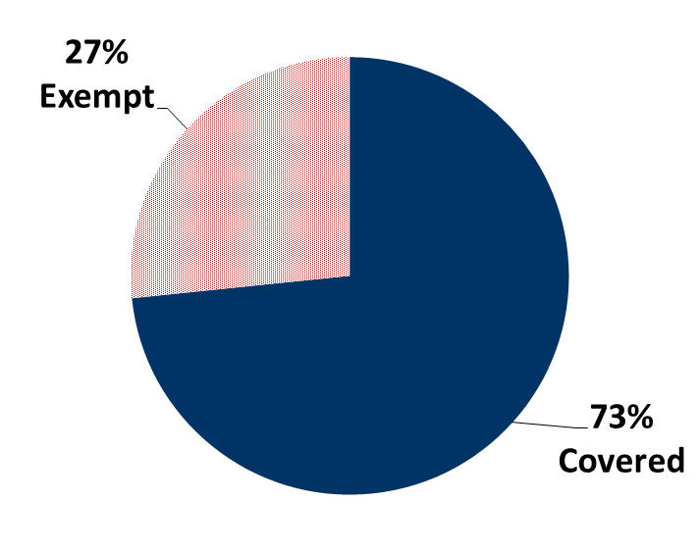
Sequester Coverage Status of 214 FFIS-Tracked Programs

Slide 18
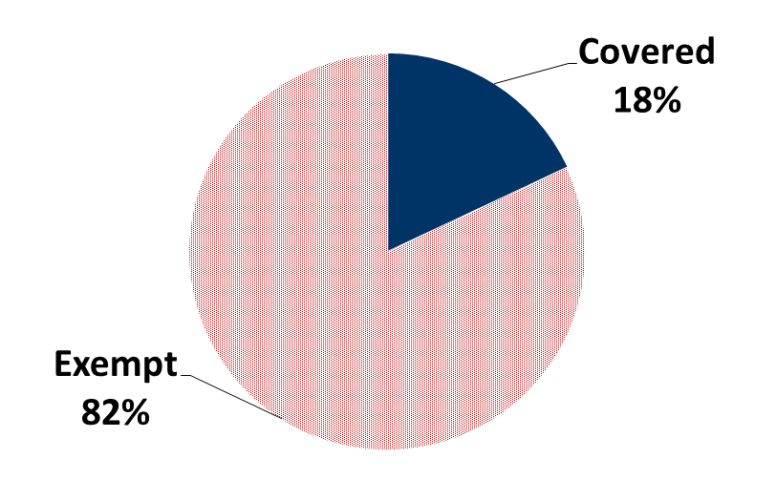
Sequester Coverage Status of $598 Billion FFIS-Tracked Funding

Slide 19
Program Areas Most Affected
Budget Function | % of Funding Covered by Sequester
Agriculture | 100%
Employment and Training | 100%
Community Development | 90%
General Gov’t | 85%
Energy, Env., Natural Resources | 78%
Justice | 62%
Education | 54%
Income Security and Social Services | 23%
Health | 4%
Transportation | 4%

Slide 20
What’s the Conventional Wisdom?
For appropriations, another CR, BUT…
For BCA, agreeing to postpone the day of reckoning, BUT…
For expiring tax provisions, a bruising fight, informed by the election.
For authorizations, probably extensions, BUT...

Slide 21
What Does this Mean for States? If Congress Goes for It…..
“Grand Bargain” means greater certainty but less funding. Likely changes include:
Reforms to entitlement programs (flexibility vs. funding)
Further reductions in discretionary spending
Revenue effects from tax overhaul, and potential loss of state-focused tax expenditures

Slide 22
What Does this Mean for States? If Congress Punts…..
States continue to face uncertainty
FY 2013 budget won’t happen anytime soon
President’s FY 2014 budget released before FY 2013 budget is finalized
Program extensions continue
In short, more of the same

Slide 23
The End: Questions?
Contact information: Trinity Tomsic
202-624-8577, ttomsic@ffis.org

