Slide 1

Fasten Your Seatbelts,
We’re in for a Bumpy Ride
HSFO Annual Conference
July 29, 2013
Federal Funds Information for States

Slide 2

A word from our sponsor…

Slide 3
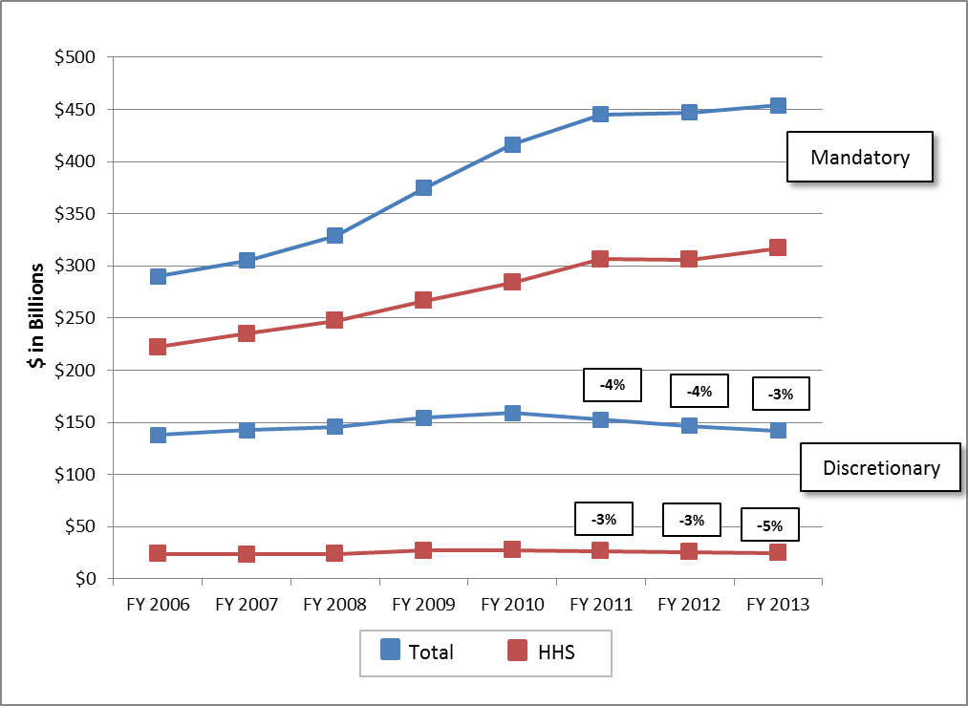
How have states fared in recent years?

Slide 4
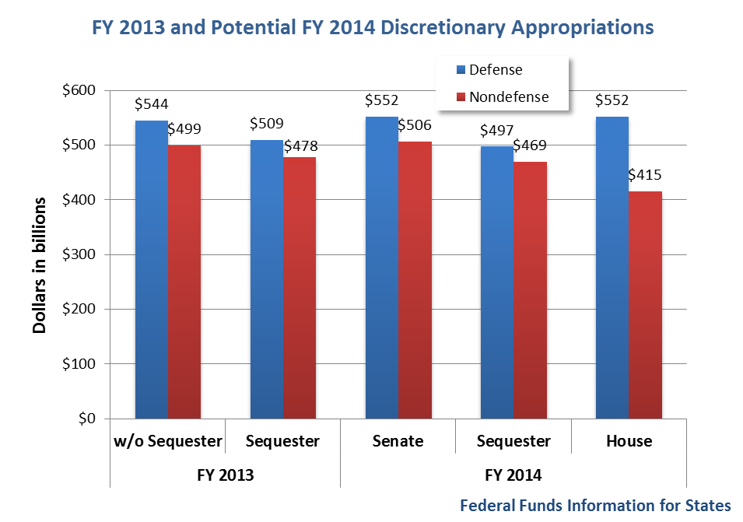
House and Senate take divergent paths in FY 2014, neither conforms to BCA

Slide 5
Divergent paths lead to different outcomes for states

Slide 6
House and Senate proceeding despite $90 billion difference

Slide 7
How do major grant programs fare?
 | ($ in millions) |  | Proposed FY 2014 vs. FY 2013
Federal Agency | FY 2012 | FY 2013 | President | House | Senate
Agriculture | $6,861 | $6,766 | 9.6% | 2.3% | 8.5%
Education | 37,273 | 35,341 | 8.7% | n/a | 6.0%
Health and Human Services | 25,180 | 24,127 | 9.6% | n/a | 13.5%
HUD | 40,812 | 39,421 | 11.5% | -0.9% | 12.2%
Energy/EPA | 2,493 | 2,349 | -8.4% | -70.7% | n/a
Justice | 1,251 | 1,221 | 4.6% | -13.0% | 15.9%
Homeland Security | 1,254 | 1,359 | 9.9% | 28.4% | 8.7%
Labor | 6,579 | 6,176 | 4.3% | n/a | 3.5%
Transportation | 54,098 | 54,532 | 0.9% | 1.4% | 1.7%

Slide 8
Funding levels for major health and human services programs
 | (in millions) |  | Proposed FY 2014 vs. FY 2013
Program | FY 2012 | FY 2013 | President | House | Senate
Substance Abuse Block Grant | $1,800 | $1,710 | 6.5% | n/a | 6.5%
Mental Health Block Grant | 460 | 437 | 5.3% | n/a | 10.8%
Maternal & Child Health Block Grant | 639 | 607 | 5.3% | n/a | 6.1%
Community Health Centers | 1,567 | 1,480 | 5.9% | n/a | 6.4%
Preventive Health Block Grant | 80 | 75 | -100.0% | n/a | 5.3%
Family Planning | 294 | 279 | 17.1% | n/a | 17.1%
Ryan White AIDS Grants | 2,392 | 2,226 | 8.4% | n/a | 7.5%
Hospital Preparedness | 375 | 358 | -28.8% | n/a | -28.8%

Slide 9
Funding levels for major health and human services programs
 | (in millions) |  | Proposed FY 2014 vs. FY 2013
Program | FY 2012 | FY 2013 | President | House | Senate
CDC-State & Local Capacity (Bioterrorism) | $657 | $623 | 4.2% | n/a | 5.9%
Head Start | 7,969 | 7,573 | 27.0% | n/a | 27.0%
Child Welfare Services | 281 | 263 | 6.8% | n/a | 6.5%
Community Services Block Grant | 677 | 635 | -44.9% | n/a | 6.5%
Child Care & Development Block Grant | 2,278 | 2,206 | 12.3% | n/a | 13.3%
Low-Income Home Energy Assistance | 3,472 | 3,261 | -8.9% | n/a | 6.3%
Refugee Assistance | 768 | 999 | 12.4% | n/a | 12.2%
Administration On Aging | 1,471 | 1,395 | 6.5% | n/a | 6.5%

Slide 10
Budget proposals to watch
Delay in ACA Disproportionate Share Hospital (DSH) reductions
Further reductions to the ACA Prevention and Public Health Fund
New set-aside requirements for substance abuse and mental health block grants
Potential cuts in Access to Recovery grants
LIHEAP funding split, formula change, and program integrity/oversight initiatives

Slide 11
Budget proposals to watch
Expansion of Early Head Start, Early Head Start-Child Care Partnerships
Community Services Block Grant (CSBG) – focus on areas of need, establish federal standards, improve program integrity

Slide 12
Will ANY new programs be funded in
FY 2014?
Proposed Program | President | House | Senate
Preschool for All (M) | $1.3B
Preschool Development Grants (D) | $750M |  | $750M
Universal Displaced Workers (M) | $4B
School Meal Equipment Grants (D) | $35M |  | $35M
Project AWARE State Grants (D) | $40M |  | $40M
Mental Health First (D) | $15M |  | $15M
Healthy Transitions | $25M |  | $0
LIHEAP Energy Burden Reduction Grants(D) | $50M |  | $0
Notes:
President’s budget included a number of new mandatory and some discretionary programs—the Senate Labor-HHS bill funds some of them
-Preschool for All: mandatory funding for universal pre-K. State grants w/ match that increases over time ($75B over 10 yrs)
-Preschool Development: competitive grants to create or expand high-quality preschool systems
-UDW: would replace WIA dislocated workers and TAA
-Project Aware: 20 grants to SEAs for comprehensive programs to make schools safer; partner with mental health and law enforcement agencies
-Health Transitions: grants to 19 states to assist 16-25 yr. olds with mental illnesses and help families navigate behavioral health systems
-Mental Health First: behavioral health workforce training

Slide 13
Upcoming congressional deadlines
October 1, 2013
Enact FY 2014 budget or pass a Continuing Resolution (CR)
October or early November 2013
Raise debt limit
January 2014
Medicaid – Qualifying Individual (QI)
Transitional Medical Assistance (TMA)
Authorize or extend Farm Bill
Authorize or extend TANF
Notes:
-CR most likely, but still debate over the overall level. Will it include sequester? May be coupled with larger budget deal
-Same for debt limit—could be part of larger deal
-Fiscal Cliff deal extended QI and TMA through December 31, 2013

Slide 14
Upcoming reauthorization bills:
Farm Bill
Major SNAP Proposals
Proposal | House (committee passed) | Senate
ARRA benefit sunset | Retains (10/31/2013) | Retains (10/31/2013)
Categorical eligibility | Limits to cash assistance only | None
“Heat and Eat” | Limits automatic HCSUA eligibility to individuals receiving $20 or more in LIHEAP benefits/year | Limits automatic HCSUA eligibility to individuals receiving $10 or more in LIHEAP benefits/year
Performance bonuses | Eliminates | Limits use to improvements in technology, administration, or actions to prevent waste, fraud, and abuse
Employment and Training | Reduces to $79M/year | Reduces to $80M in FY 2018
Notes:
-HHFKA moved up the sunset date of the additional SNAP benefits under ARRA
-Cash assistance under SSI, TANF, or other state assistance program; 40 states and DC affected (offer broad based categorical eligibility)
-Go to next slide for Heat and Eat
1households can qualify for Heating and Cooling Standard Utility Allowance if they provide proof that they pay heating and cooling expenses or receive LIHEAP benefits. HCSUA is then deducted from participants income and assets to determine SNAP benefit. Some states send token LIHEAP benefit amounts to SNAP participants in order to automatically qualify them for HCSUA.
-currently states receive $48M/year in performance bonuses
-E&T current law is $90M/yr.

Slide 15
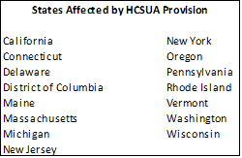
States affected by “heat and eat” proposal
Notes:
-mention Montana ($50) and NH (LIHEAP application qualifies for HCSUA, so can increase SNAP benefits)

Slide 16
Other nutrition proposals
Program | House (committee passed) | Senate
TEFAP | -$20M in additional funds for FYs 2014-2018, indexed to Thrifty Food Plan -Funds available for two years | -$54M in additional funds for FYs 2014-2018, indexed to Thrifty Food Plan -Funds available for two years
Nutrition Education | $375M in FY 2014, then indexed to inflation | Same as current law: $401M in FY 2014, $407M in FY 2015, then indexed to inflation
CSFP | Reauthorizes “such sums as necessary” | Reauthorizes “such sums as necessary”
Hunger-Free Communities | No reauthorization | $100M in total mandatory funds for FYs 2014-2018; authorizes $5M/year in discretionary funds
Healthy-Food Financing Initiative | Authorizes one-time funding of $125M available until expended | Authorizes one-time funding of $125M available until expended
Nutrition Information and Awareness | Repealed | Repealed
SFMNP | $20.6M/year plus “such sums as necessary” to carry out expansion | $20.6M/year
Notes:
TEFAP: base indexed and extra mandatory funding on top; Senate bill spreads additional funding over years, House bill only in FY 2014
-HFFI: provides funding to community development financial institutions to create revolving loan programs for healthy food retails to overcome high costs of entry to underserved areas
-NEOB: House FY 2014 spending bill reduces to $350M

Slide 17
Where does the nutrition title stand?
House bill dropped the nutrition title
May be added back in conference with Senate bill
If not reauthorized, funding for SNAP can continue through the appropriations process
BUT, funding levels would be set by appropriators
Other mandatory programs that are not appropriated would expire
Notes:
SFMNP is the big mandatory program that would be effected. Others through the appropriations process

Slide 18
Upcoming reauthorization bills: WIA
House has approved SKILLS Act (H.R. 803)
  Consolidates 34 current workforce and vocational rehabilitation programs
  Creates Workforce Investment Fund (block grant to states)
  New funding formula for WIF
Senate HELP committee has released draft text
  Maintains separate WIA formula grant programs, but sets aside funding for innovation and replication projects
Notes:
Senate committee will officially introduce and start mark-up this week

Slide 19
Proposed consolidations in H.R. 803
Program | Federal Agency | Program | Federal Agency
SNAP Employment and Training | USDA | Environmental Workforce Development and Job Training Grants | EPA
Youth Conservation Corps | USDA/DOI | Refugee and Entrant Assistance-Targeted Assistance Grants | HHS
Grants to States for Training for Incarcerated Individuals | ED | Refugee and Entrant Assistance-Social Services Program | HHS
Migrant and Seasonal Farmworkers Program | ED | Refugee and Entrant Assistance-Targeted Assistance Discretionary | HHS
National Institute for Literacy | ED | Second Chance Act Prisoner Reentry Initiative | DOJ
In-Service Training of Rehabilitation Personnel | ED | Community-Based Job Training Grants | DOL
Projects with Industry | ED | Disabled Veterans Outreach Program | DOL
VR Recreational Programs | ED | ES Statistical Programs | DOL
State Supported Employment Services Program | ED | Green Jobs Act | DOL
Notes:
-point out HHS grants

Slide 20
Proposed consolidations in H.R. 803
Program | Federal Agency | Program | Federal Agency
Local Veterans Employment Reintegration Program | DOL | WIA Dislocated Workers | DOL
National Farmworker Jobs Program | DOL | WIA Pilot and Demonstration Projects | DOL
Native American Employment and Training | DOL | WIA National Emergency Grants | DOL
Reintegration of Ex-Offenders | DOL | WIA Youth | DOL
Senior Community Service Employment Program | DOL | Women in Apprenticeship and Nontraditional Occupations | DOL
Veterans Workforce Investment Program | DOL | Workforce Innovation Fund | DOL
Wagner-Peyser Employment Services | DOL | Youth Opportunity Jobs Grants | DOL
WIA Adult | DOL | YouthBuild | DOL

Slide 21
TANF reauthorization long overdue
Last long-term reauthorization in FY 2005
  Seven short-term extensions, latest expires 9/30/13
    Includes TANF (block grant, supplemental, contingency); healthy marriage promotion/responsible fatherhood; mandatory/matching CCDF)
    New programmatic requirements
    Excluded funding for TANF supplement grants
    Reduced funding for TANF contingency fund
  TANF contingency fund authorized through 9/30/14

Slide 22
Recent TANF reauthorization proposals
President’s FY 2014 budget
  Doesn’t include full proposal but specifies any reauthorization should use performance indicators
  Makes supplemental grants permanent part of TANF
    Offset by TANF contingency fund reductions
House-passed legislation (H.R. 890)
  Short-term reauthorization through 12/31/13
  Blocks administration from exercising waiver authority

Slide 23
Any more changes in the pipeline?
CMS release of final methodology for DSH reductions
NIPA Benchmarking will affect FY 2015 FMAPs
States required to report new data for LIHEAP performance measures in FY 2014
  Average reduction in energy burden for households receiving LIHEAP fuel assistance
  Percent of unduplicated households where LIHEAP prevented a potential home energy crises
  Percent of unduplicated households where LIHEAP benefits restored home energy

Slide 24
Any more changes in the pipeline?
CCDF proposed regulations makes significant policy changes; could result in large fiscal impact
  Specifies minimum state health and safety standards for child care providers
  Increases state monitoring of child care providers
  Requires states to establish provider-specific quality indicators
  Amends eligibility requirements
  Strengthens program integrity (error rates, internal controls)

Slide 25
Will Congress do something?
How will the $90 billion gap be bridged?
Will Congress pass a CR and for how long?
Does the CR abide by the BCA?
Will Congress continue to rely on program extensions? Will they be “clean”? Will they get caught up in the budget debate?
Will the debt ceiling be an “action forcing” event?
Notes:
-both sides holding ground on overall spending level for FY 2014 CR. Not clear whether it will include sequester
-discussions starting on broader budget deal btw White House and Senate Republicans, focusing on possible areas for negotiation in entitlement spending. Entitlement reform to replace sequester

Slide 26

Questions?
For more information, visit www.ffis.org
or contact:
Trinity Tomsic (ttomsic@ffis.org)
Melissa Loeb (mloeb@ffis.org)

