Slide 1
Federal Grants:
The Lay of the Land
FFIS Grants Training, October 2016

Slide 2
Federal Grants
  How do they work?
  Why does it matter?

Slide 3
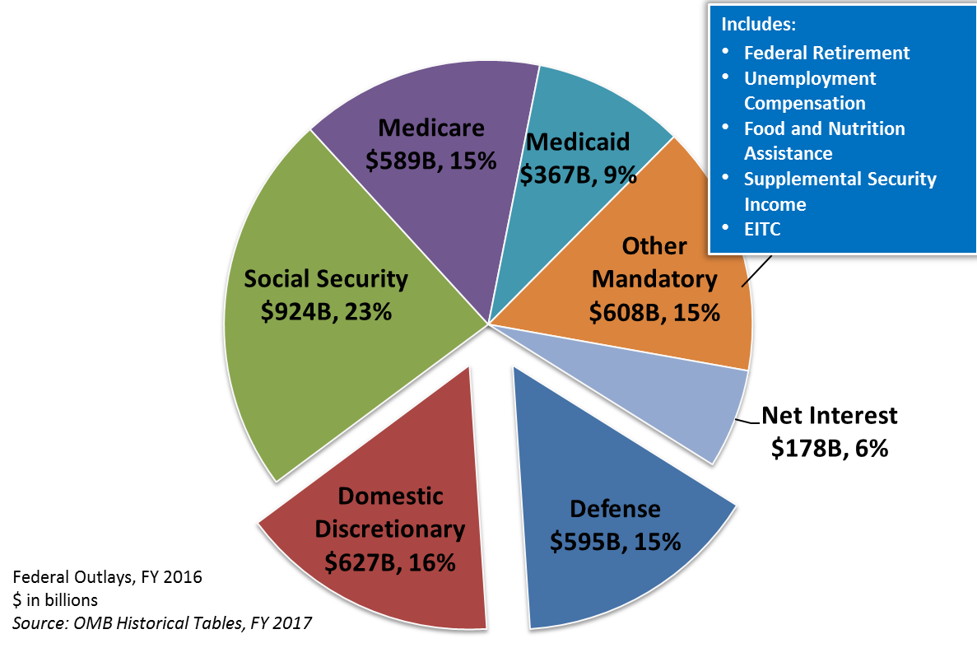
Most spending is spoken for

Slide 4
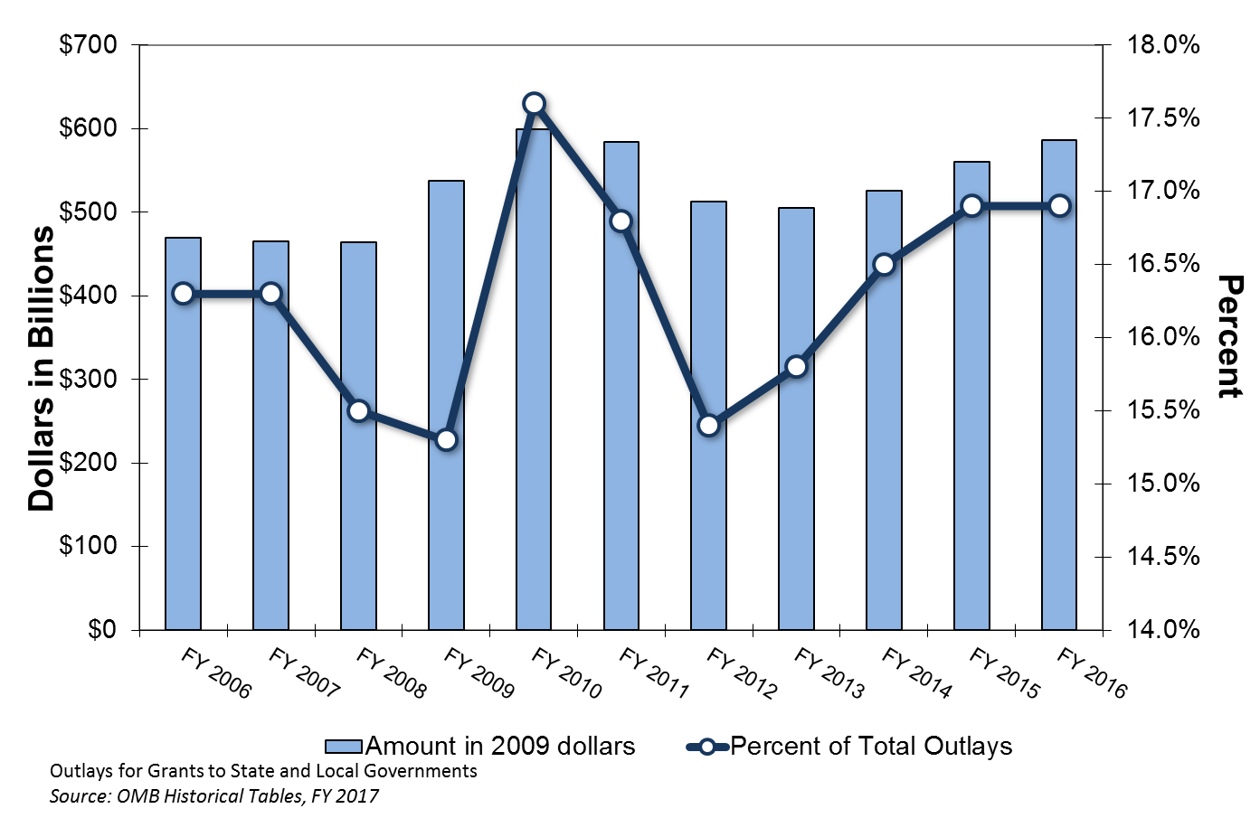
Grants play a minor role in federal spending…

Slide 5
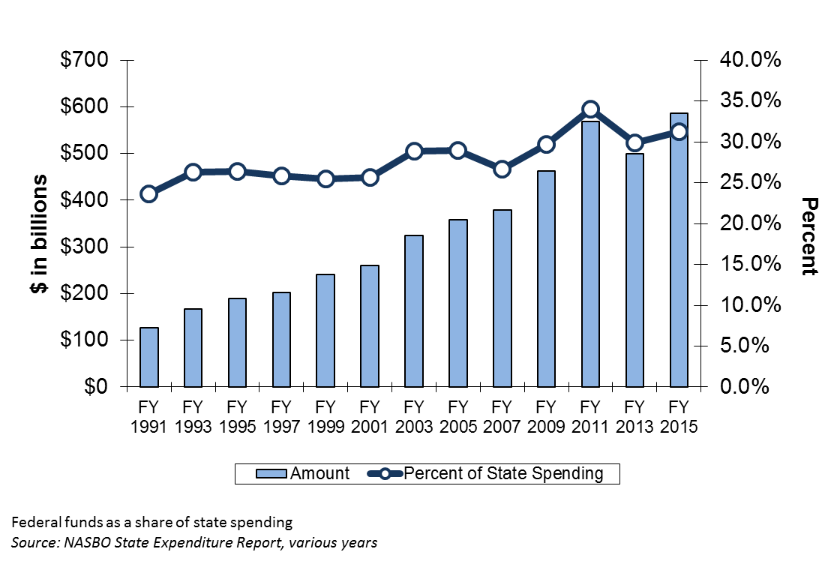
…but a large and growing role in state budgets

Slide 6
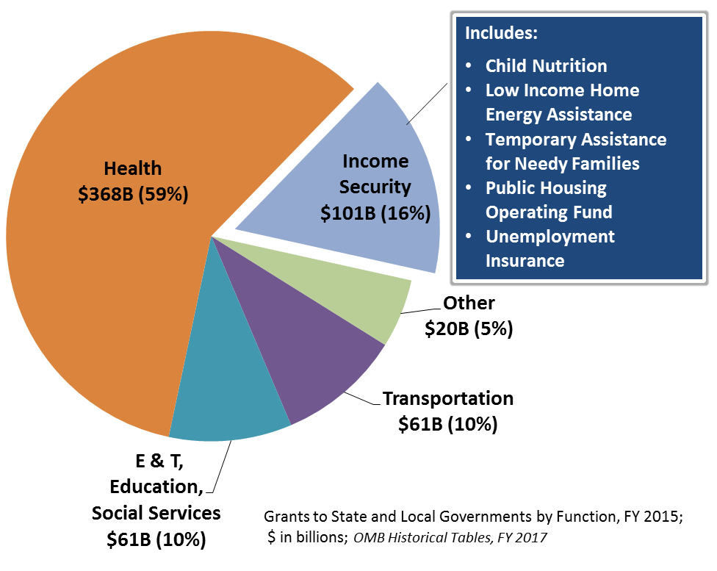
Health dominates

Slide 7
10 largest grants = 79% of total

Slide 8
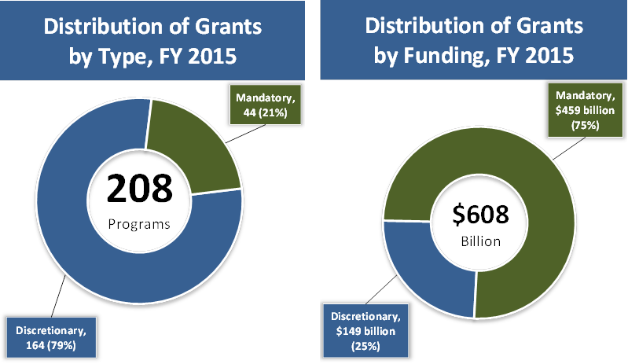
Most grants are discretionary, but most funding is mandatory

Slide 9
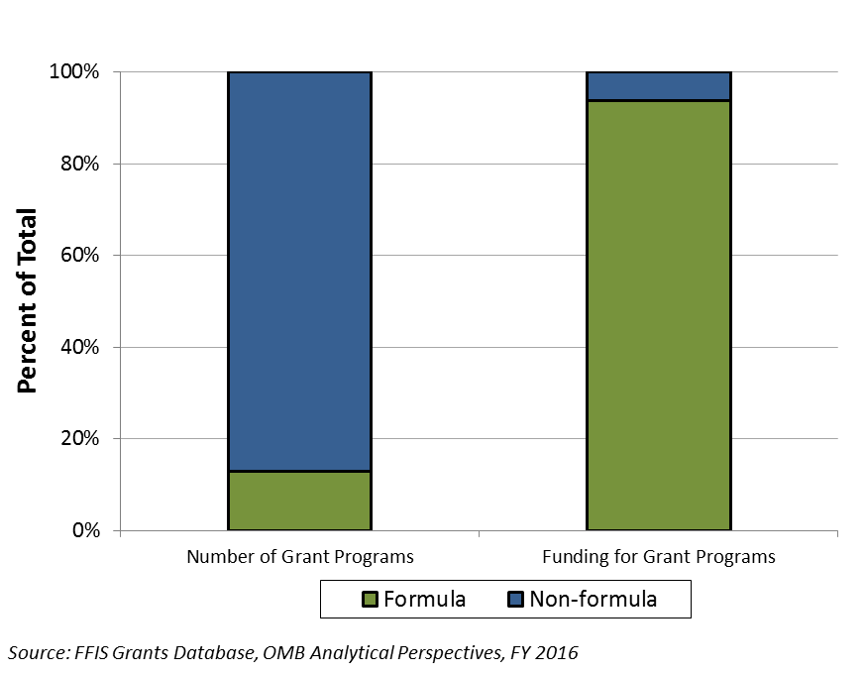
Most grants are competitive, but most funding is by formula

Slide 10
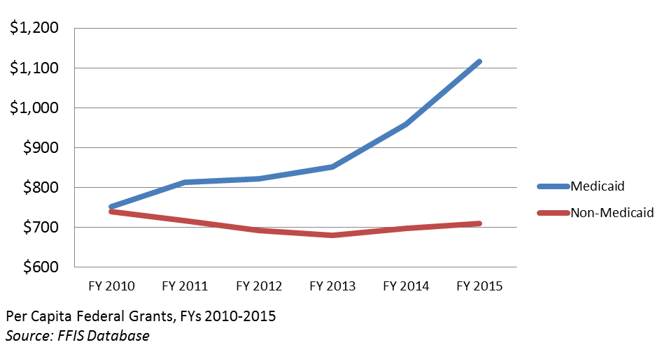
The big story in federal aid

Slide 11
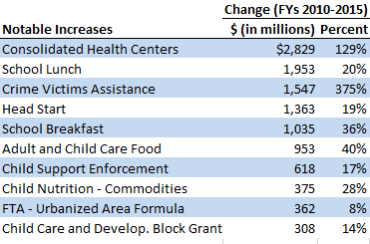
Winners in the last five years

Slide 12
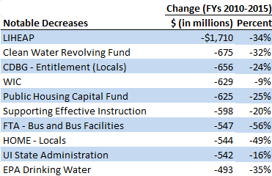
Losers in the last five years

Slide 13
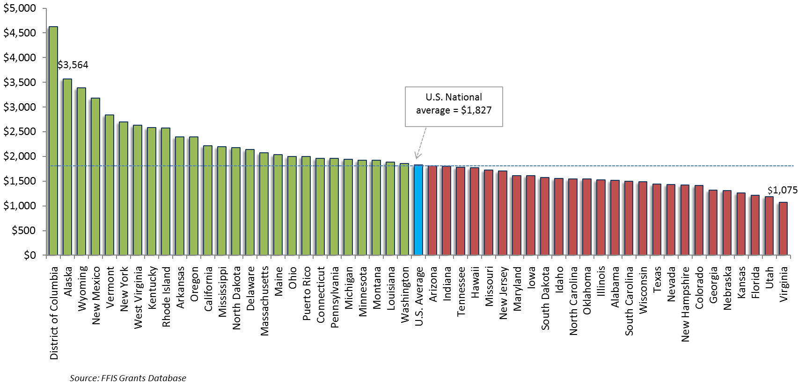
FY 2015 grants per capita varied widely

Slide 14
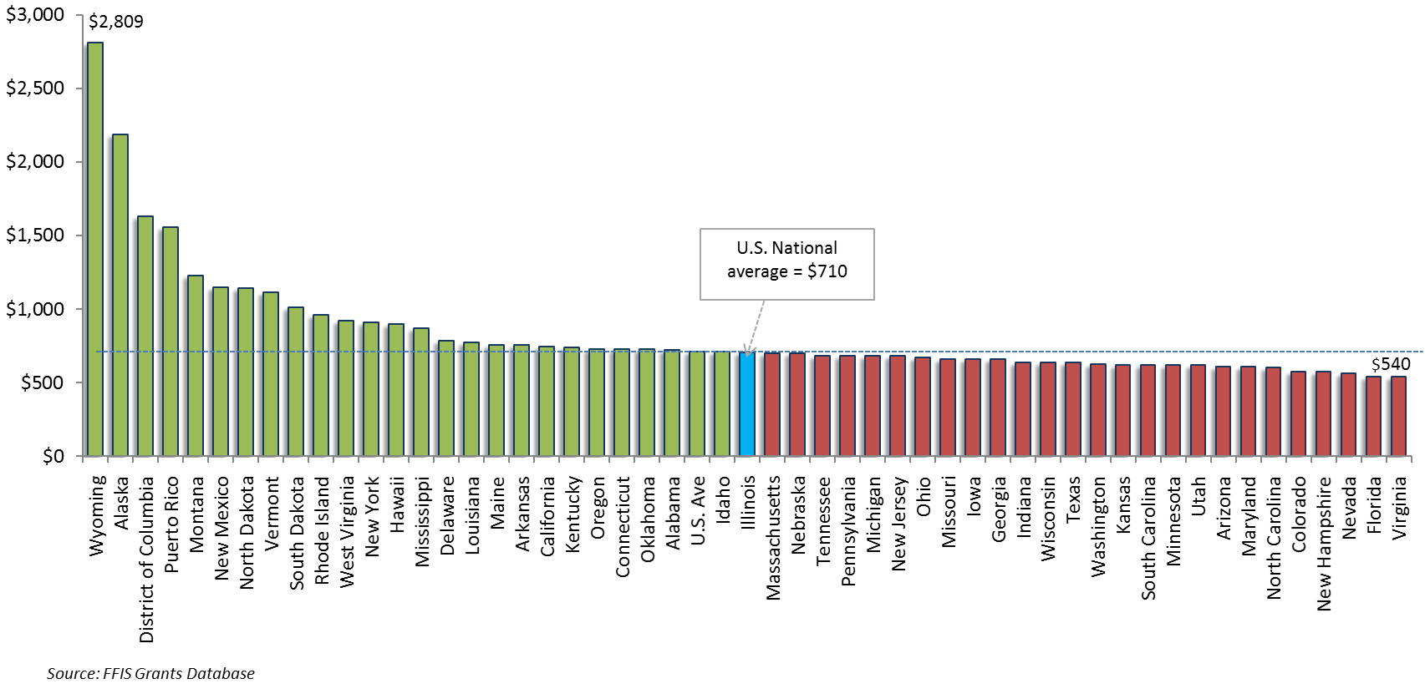
Removing Medicaid levels the playing field for many states

Slide 15
What influences results?
Medicaid
Robust program
Income
Low income
Population
Small-state minimums
Geography
Large federal
land holdings
Federal
matching rate
Natural resources
High poverty
ACA
expansion
Demographics of population

Slide 16
Medicaid drives overall results
Medicaid
Robust program, ACA expansion
DC, NY, RI, VT
High matching rate
NM, WV, KY, AR

Slide 17
Shared revenues important for some states
Programs
Mineral Leasing
TVA: Payments in Lieu of Taxes
States
Wyoming
Internal Revenue Collections for PR
BLM: Payments in Lieu of Taxes
National Forests
New Mexico
Puerto Rico
North Dakota
Arkansas
Montana
Oregon

Slide 18
Many formulas rely on demographics and income
Low per capita personal income
High poverty
Mississippi
Population growth
Colorado
DC
North Dakota
Texas
Utah
West Virginia
New Mexico
Idaho
South Carolina
Mississippi
New Mexico
Louisiana
Alabama
Kentucky
High child poverty
Michigan
New Mexico
Arkansas
Louisiana
South Carolina

Slide 19
Several states benefit from small-state minimums
Alaska
Vermont
DC
Hawaii
Idaho
South Dakota
North Dakota
New Hampshire
Montana
Maine
Rhode Island
Wyoming
Delaware

Slide 20
A Federal Update
  What’s on our radar?

Slide 21
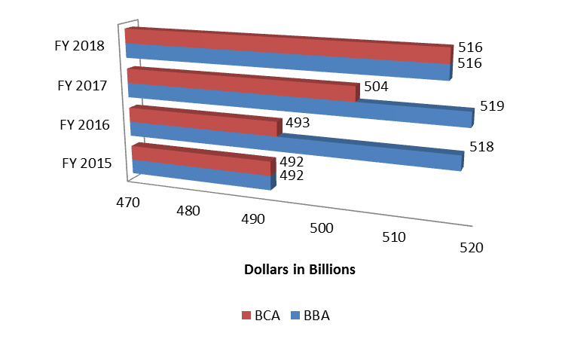
Non-defense spending in BBA

Slide 22
Major provisions in CR
Funding
Expires December 9
$1.1B for Zika
$27M for opioid legislation
Programs
Extends TANF, CCDF
Technical fixes
-0.496% ATB cut (discretionary)
$500M for disaster relief

Slide 23
Potential lame-duck issues
Opioids
Big increase likely, but how big?
Will new programs get funded?
Child Welfare
Senate action?
Funding gains and losses
TANF
Piecemeal reforms?
Extension?

Slide 24
Potential lame-duck issues
WRDA
Drinking water disaster relief
New programs, funding
Child Nutrition
Nutrition standards
Flexibility, access
Mental Health
Senate action?
Additional funding?

Slide 25
Hot Topics
FY 2018 FMAPs
25 states ; big increases in 10
12 states 
Part B
$1.1B  projected (CY 2017)
Congressional fix?
Clawback
$1.1B  projected (CY 2017)

Slide 26
End-Game Speculation
Congress returns Nov. 14 with a 3-week window under CR
FY 2017 minibuses or omnibus?
New funding for opioids likely
Other loose ends could get tied up
A LOT depends on election

Slide 27
FFIS resources
Federal Grants Per Capita, FY 2015: Special Analysis 16-02
CR: Budget Brief 16-08
Water resources: Issue Brief 16-47
TANF reauthorization: Issue Brief 16-37
Child welfare: Issue Brief 16-34
Child nutrition: Issue Brief 16-06
Comprehensive Addiction and Recovery Act: Issue Brief 16-37
FY 2018 FMAPs: Issue Brief 16-49
Medicare Part B premiums: Issue Brief 16-39
Medicare clawbacks: Issue Brief 16-19
FEMA issues: Issue Brief 16-02, Issue Brief 16-48

Slide 28
Questions?
Check for updates at www.ffis.org
  ttomsic@ffis.org; 202-624-8577

