Slide 1
Illinois and Federal Grants
Federal Funds Information for States www.ffis.org
May 2015

Slide 2
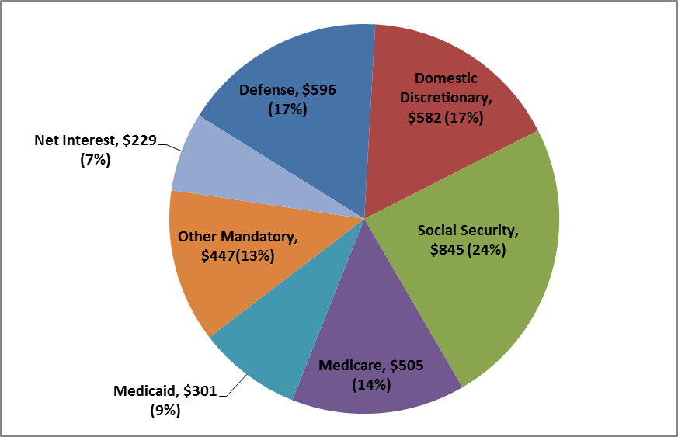
Where the money goes: pieces of the federal budget pie
Composition of Federal Outlays in FY 2014 ($ in Billions, % of Total)

Slide 3
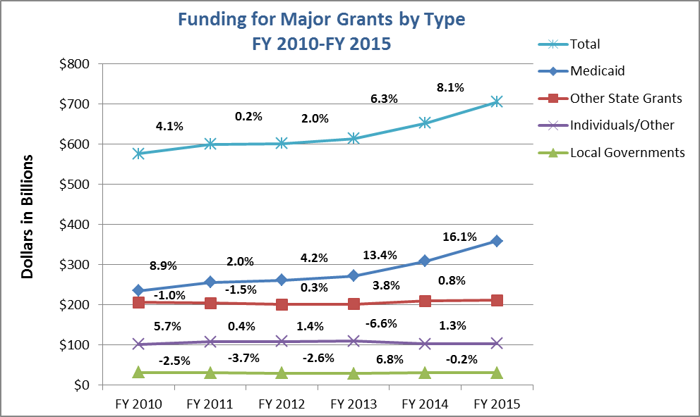
Recent trends in grant funding

Slide 4
Federal grants going to Illinois: per capita, 2014
Major Category | U.S. Average Per Capita | Illinois Per Capita | Illinois Rank
Medicaid | $958 | $695 | 39
Other State | 601 | 567 | 35
Local | 91 | 113 | 12
Individual/Other | 319 | 356 | 17
Total | $1,969 | $1,731 | 40

Slide 5
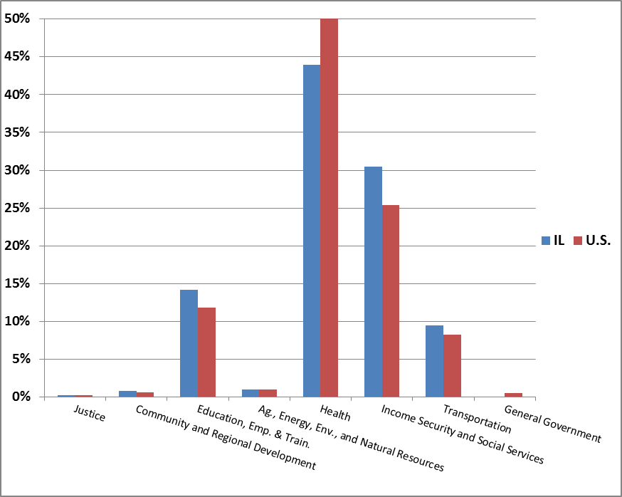
Federal grants going to Illinois: share of funding by function

Slide 6
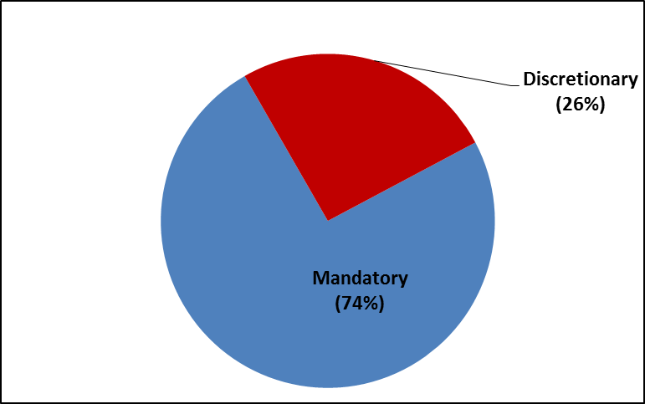
Mandatory vs. discretionary funding to states

Slide 7
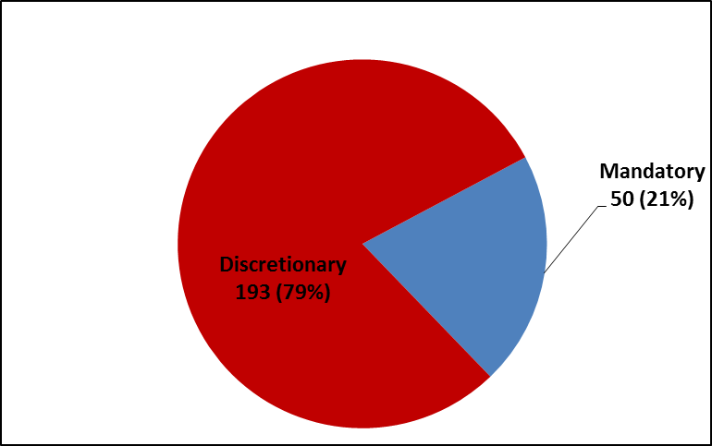
Mandatory vs. discretionary grants to states

Slide 8
20 largest discretionary grants going to Illinois
Rank | CFDA | Program | FY 2015 ($ in 000s) | % of Total | Cumulative
1 | 20.205 | National Highway Performance Program | $791,860 | 13% | 13%
2 | 84.010 | Comp Ed (Title I) - Local Education Agencies | 664,790 | 11% | 23%
3 | 84.027 | Special Education Basic State Grant | 500,249 | 8% | 31%
4 | 20.205 | Surface Transportation Program | 364,991 | 6% | 37%
5 | 93.600 | Head Start | 321,286 | 5% | 42%
6 | 20.507 | FTA - Urbanized Area Formula | 266,210 | 4% | 47%
7 | 14.850 | Public Housing Operating Fund | 247,916 | 4% | 51%
8 | 20.525 | FTA - State of Good Repair Grants | 219,112 | 4% | 54%
9 | 10.557 | WIC - Supplemental Feeding Program | 209,453 | 3% | 58%
10 | 93.224 | Consolidated Health Centers | 195,816 | 3% | 61%

Slide 9
20 largest discretionary grants going to Illinois
Rank | CFDA | Program | FY 2015 ($ in 000s) | % of Total | Cumulative
11 | 93.568 | Low Income Home Energy Assistance | $165,495 | 3% | 63%
12 | 20.106 | Airport Improvement Program | 162,172 | 3% | 66%
13 | 17.225 | UI State Administration Base Allocation | 151,905 | 2% | 69%
14 | 14.218 | Comm Devel. Block Grant - Entitlement (Locals) | 123,124 | 2% | 70%
15 | 14.872 | Public Housing Capital Fund | 115,854 | 2% | 72%
16 | 20.205 | Congestion Mitigation & Air Quality | 109,991 | 2% | 74%
17 | 84.367 | State Grants for Improving Teacher Quality | 93,694 | 2% | 76%
18 | 93.575 | Child Care & Devel. Block Grant | 83,274 | 1% | 77%
19 | 20.205 | Highway Safety Improvement Program | 76,854 | 1% | 78%
20 | 93.959 | Substance Abuse Prevent. & Treatment Block Grant | 67,211 | 1% | 79%

Slide 10
20 largest mandatory grants going to Illinois
Rank | CFDA | Program | FY 2015 ($ in 000s) | % of Total | Cumulative
1 | 93.778 | Medicaid - Vendor Payments | $10,445,557 | 61% | 61%
2 | 10.551 | Supplemental Nutrition Assistance Program (SNAP) Benefits | 3,246,704 | 19% | 80%
3 | 93.558 | Temporary Assistance For Needy Families | 585,057 | 3% | 84%
4 | 93.778 | Medicaid - Administration | 559,860 | 3% | 87%
5 | 10.555 | Child Nutrition - School Lunch | 436,607 | 3% | 90%
6 | 93.767 | Children's Health Insurance Program | 312,423 | 2% | 91%
7 | 93.658 | Foster Care | 176,375 | 1% | 92%
8 | 93.268 | Vaccines for Children | 146,952 | 1% | 93%
9 | 10.561 | SNAP State Administration | 139,111 | 1% | 94%
10 | 93.563 | Child Supp. Enforcement Administration | 132,694 | 1% | 95%

Slide 11
20 largest mandatory grants going to Illinois
Rank | CFDA | Program | FY 2015 ($ in 000s) | % of Total | Cumulative
11 | 10.558 | Child Nutrition - Adult & Child Care Food | $130,488 | 1% | 96%
12 | 93.596 | Child Care Entitle. Mandatory & Matching | 126,292 | 1% | 96%
13 | 10.553 | Child Nutrition - School Breakfast | 125,413 | 1% | 97%
14 | 84.126 | OSERS - Rehab. Services - Basic State Grant | 109,582 | 1% | 98%
15 | 93.659 | Adoption Assistance | 85,989 | 1% | 98%
16 | 93.667 | Social Services Block Grant | 64,275 | 0% | 99%
17 | 10.555 | Child Nutrition - Commodities | 60,534 | 0% | 99%
18 | 16.575 | OVC - Crime Victims Fund - Assistance | 51,907 | 0% | 99%
19 | 15.252 | Abandoned Mine Reclamation Fund | 15,718 | 0% | 99%
20 | 16.576 | OVC - Crime Victims Fund - Compensation | 14,090 | 0% | 100%

Slide 12
grant resources
FFIS Publications
FFIS Grants Database: http://www.ffis.org/database
FFIS Federal Grant Inventory: http://www.ffis.org/node/3720
FY 2013 Per Capita Federal Spending on Major Grant Programs: http://www.ffis.org/node/3400
Upcoming Program and Budget Deadlines: http://www.ffis.org/node/3734
Establishing a Grants Office: http://www.ffis.org/node/3430
Federal Spending Data by State
USAspending.gov: https://www.usaspending.gov/Pages/Default.aspx
State Smart-Federal Funds in 50 States: https://www.nationalpriorities.org/smart/
Pew’s Federal Spending in the States: http://www.pewtrusts.org/en/research-and-analysis/issue-briefs/2014/12/federal-spending-in-the-states
Catalog of Federal Domestic Assistance (CFDA.gov)
Funding announcements (grants.gov)

