Slide 1
Federal Update:
Progress? Or Same Old, Same Old?
HSFO Annual Meeting
Sparks, NV
July 2015

Slide 2
Overview
FY 2016 appropriations
Reconciliation
Reauthorizations
Child Welfare Financing
Debt Limit
Other issues/deadlines

Slide 3
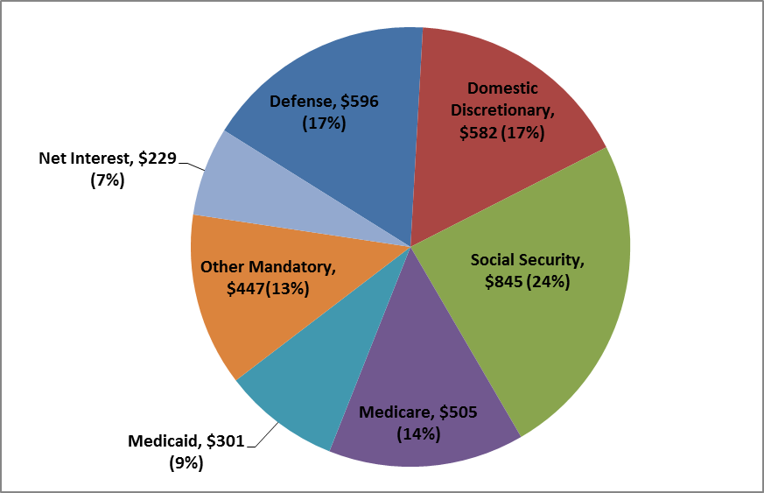
Where the money goes: pieces of the federal budget pie
Composition of Federal Outlays in FY 2014
($ in billions, % of total)

Slide 4
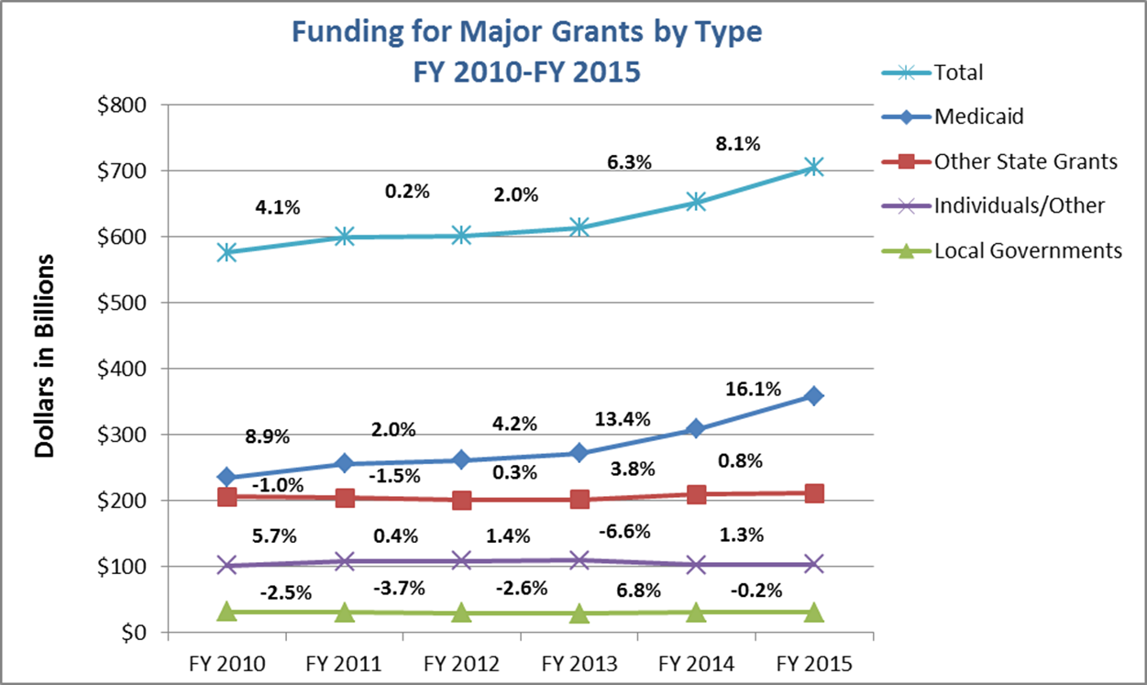
Many grants have been flat…

Slide 5
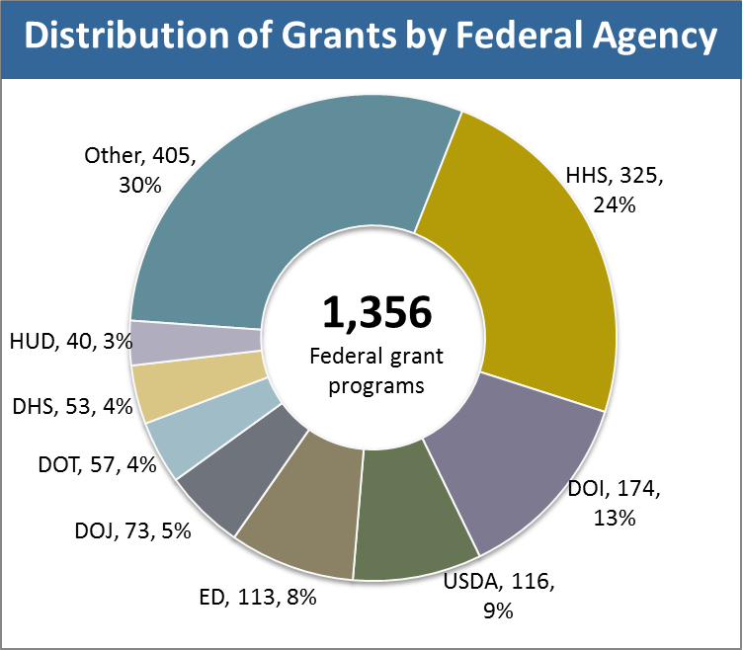
HHS has largest number of grants

Slide 6
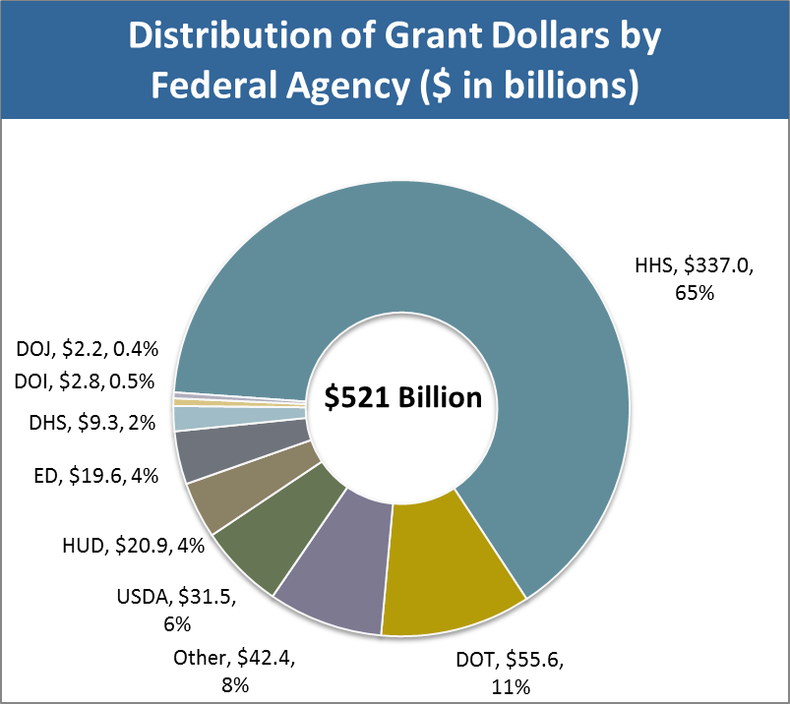
HHS distributes the most funding

Slide 7
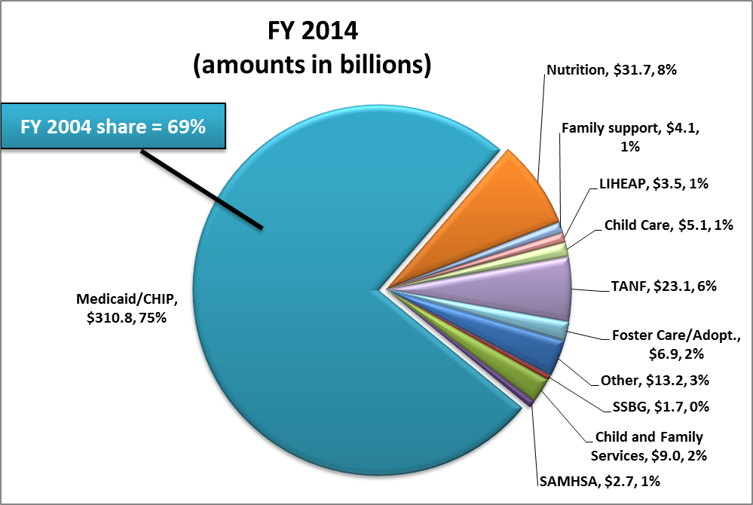
Major health and human services grants

Slide 8
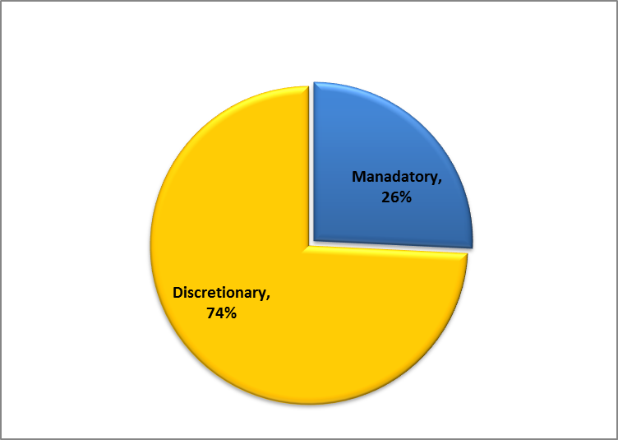
Mandatory vs. discretionary HHS grants to states

Slide 9
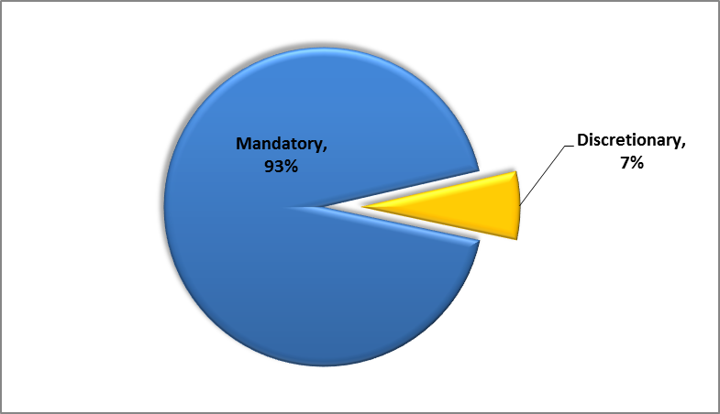
Mandatory vs. discretionary HHS funding to states

Slide 10
2015 Congressional “To Do” List
Done | Must Do | May Do
CHIP Extension | Appropriations | Older Americans Act (OAA) Reauthorization
Health Extenders | Reconciliation | Child Welfare Financing Reform
Human Trafficking | TANF Extension | TANF Reauthorization
 | Child Nutrition Extension | Child Nutrition Reauthorization
 | Debt Limit

Slide 11
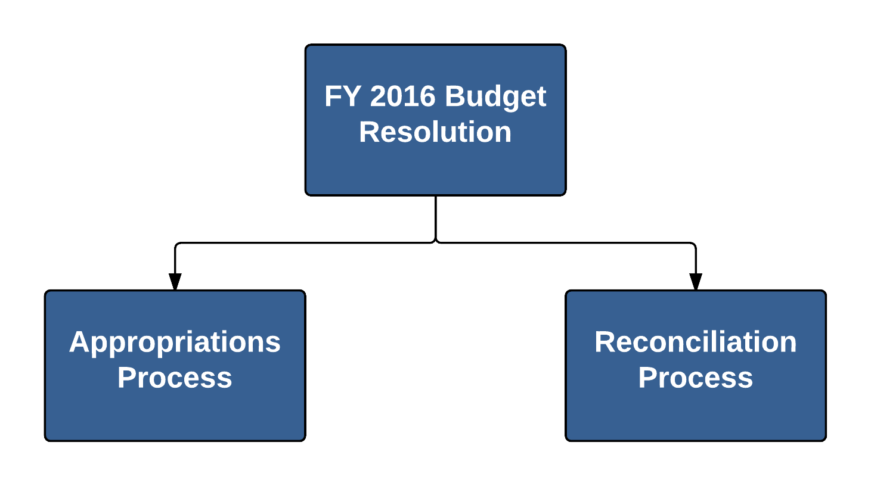
Budget Resolution Process

Slide 12
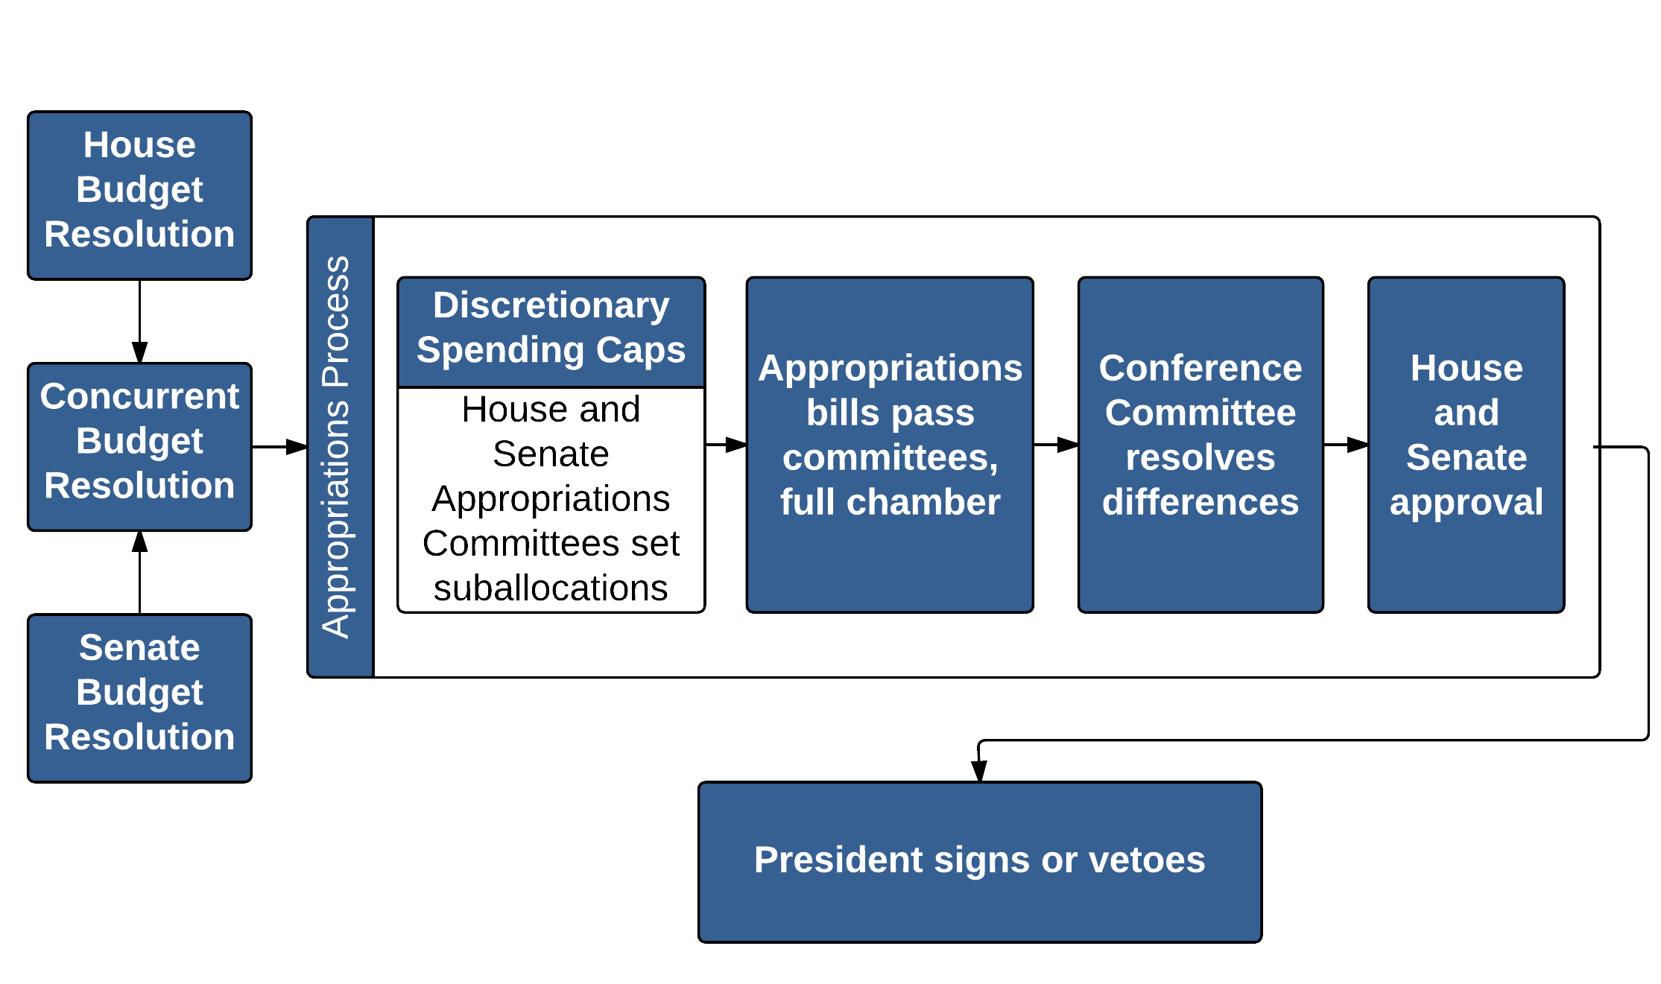
Appropriations Process

Slide 13
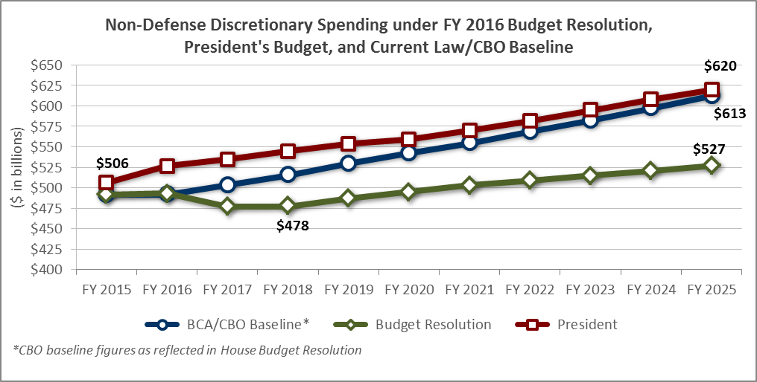
Divergent paths create problems

Slide 14
…and the future is uncertain

Slide 15
Differences of magnitude, not direction

Slide 16
The most progress in years

Slide 17
There’s always a “but”
OMB recommends a veto of any legislation "that implements the current Republican budget framework.“
CR all but certain.
A new budget deal to override the BCA?
  Changes to mandatory programs?
Focus on timing: a mid-December convergence?

Slide 18
How do major program areas fare?
 | ($ in millions) | Proposed FY 2016 vs. FY 2015
Federal Agency | FY 2015 | President | House | Senate
Agriculture | $6,902 | 0% | -2% | -1%
Education | 36,547 | 6% | -4% | -2%
HHS | 26,714 | 5% | -2% | -1%
HUD | 42,269 | 8% | 3% | 2%
Energy/EPA | 2,599 | 0% | -22% | -20%
Justice | 1,255 | 1% | 6% | -3%
Homeland Security | 1,482 | 1% | 0% | -1%
Labor | 6,066 | 10% | -0% | -4%
Transportation | 55,568 | 29% | -0% | -1%
Total – Discretionary | 179,614 | 13% | -1% | -1%

Slide 19
A few programs may see increases
 | ($ in millions) | Proposed FY 2016 vs. FY 2015
Program | FY 2015 | President | House | Senate
Head Start | $8,598 | 18% | 2% | 1%
Child Care & Development Block Grant | 2,435 | 11% | 0% | 6%
Family Violence/Battered Women’s Shelters | 135 | 11% | 7% | 0%
Poison Control Centers | 19 | 0% | 16% | 0%
Rural Outreach Grants | 59 | 0% | 0% | 8%
Garrett Lee Smith State Grants | 35 | 0% | 34% | 0%
Heart Disease and Stroke | 130 | 0% | 31% | 0%
Diabetes | 140 | 0% | 28% | 0%
Oral Health | 16 | 0% | 27% | 0%

Slide 20
Some programs are at risk
 | ($ in millions) | Proposed FY 2016 vs. FY 2015
Program | FY 2015 | President | House | Senate
Refugee Assistance | $1,560 | 3% | -8% | -10%
State Health Insurance Program | 52 | 0% | 0% | -42%
Developmental Disabilities – State Councils | 72 | 0% | 0% | -5%
Developmental Disabilities – Protection and Advocacy | 39 | 0% | 0% | -5%
Teen Pregnancy Prevention | 108 | 4% | -81% | -81%
Rural/Community Access to Emergency Devises | 5 | -100% | 0% | -100%
Maternal and Child Health Block Grant | 637 | 0% | 0% | -3%

Slide 21
Some programs are at risk
 | ($ in millions) | Proposed FY 2016 vs. FY 2015
Program | FY 2015 | President | House | Senate
Substance Abuse Block Grant | $1,820 | 0% | 0% | -3%
Family Planning | 287 | 5% | -100% | -10%
Section 317 Immunization | 611 | -8% | -4% | 0%
Sexually Transmitted Infections | 157 | 0% | 0% | -20%
REACH | 51 | -100% | -2% | -100%
Community Prevention Grants | 80 | -25% | -100% | -100%
Primary/Behavioral Health Integration | 50 | -48% | -14% | 0%
Screening, Brief Intervention, Referral and Treatment | 47 | -36% | 0% | -36%
Access to Recovery | 38 | -100% | 0% | -100%
Projects for Assistance in Transition to Homelessness | 65 | 0% | -15% | -38%

Slide 22
Will any new initiatives be funded?
Prescription Drug Abuse (SAMHSA, CDC)
Antibiotic Resistance Initiative (CDC)
  House ($120M), expand state laboratory capacity
  Senate ($30M), support collaborations
 | ($ in millions) | Proposed FY 2016 vs. FY 2015
Program | FY 2015 | President | House | Senate
Prescription Drug Overdose (CDC) | $20 | $68 | $70 | $32
Targeted Capacity Expansion (SAMHSA) | 23 | 36 | 36 | 29
Grants to Prevent Prescription Drug/Opioid Overdose (SAMHSA) | 0 | 12 | 0 | 6

Slide 23
How will appropriations affect ACA?
Potential reductions to existing programs because of new ACA coverage
Allocation of Prevention and Public Health Fund
Proposed mandatory rescissions
Preventing use of discretionary funding for ACA

Slide 24
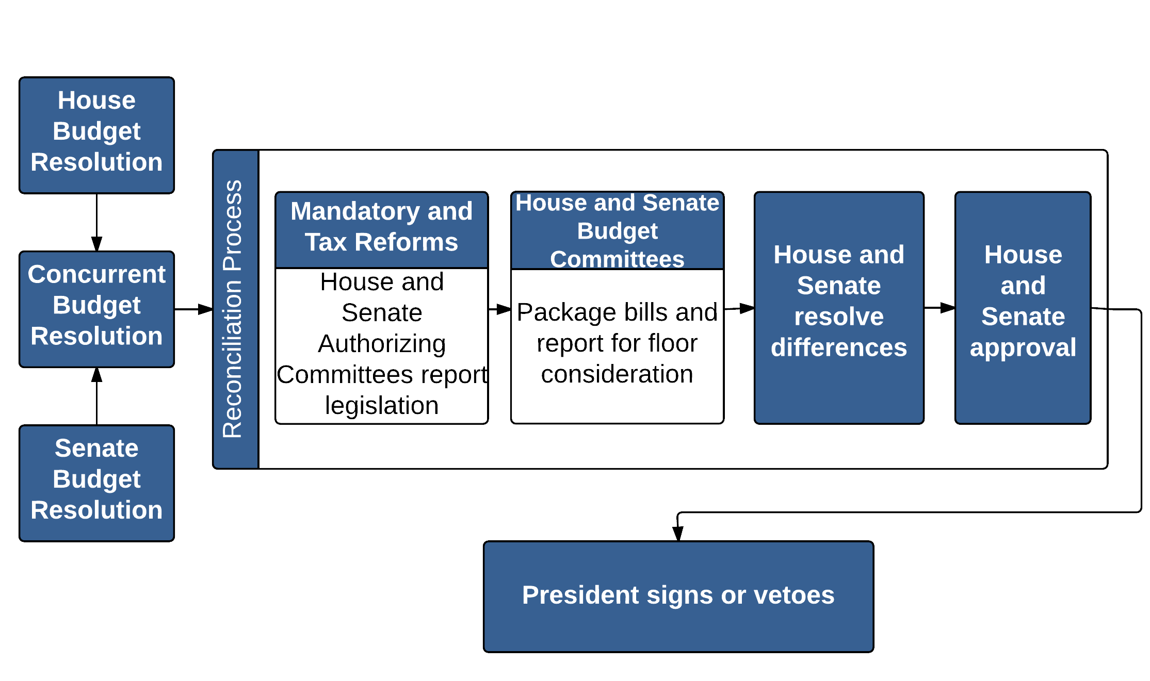
Reconciliation Process

Slide 25
All’s quiet on the reconciliation front
July 24 deadline (missed)
Committees determine policies, but there is disagreement over approach
President must sign

Slide 26
Illustrative examples

Slide 27
Doc Fix Enacted
Doc fix enacted:
  Extends CHIP funding with 23 percentage-point E-FMAP increase (through FY 2017)
  Extends related programs through FY 2017
  Permanently extends QI and TMA; other ACA-related programs extended through FY 2017
Delays DSH reductions until FY 2018

Slide 28
Doc Fix: select program extensions

Slide 29
Human Trafficking Law Enacted
Establishes Domestic Trafficking Victims Fund, effective FY 2016
  Financed by penalties and Community Health Center transfer
  Funding not subject to appropriations process (HHS/DOJ determine distribution)
New Victim-Centered Child Human Trafficking Deterrence Block Grant
  Competitive grants to state/local government
  Matching requirement
New HHS Office on Trafficking in Persons

Slide 30
Domestic Trafficking Victims Fund

Slide 31
Senate passes OAA reauthorization
Authorizes funding through FY 2018
Modifies Title III (state grants) hold-harmless provision
  Current law = FY 2006 allotment
  FY 2016-2018 = 99% of prior-year allotment
  FY 2019 and beyond = FY 2018 allotment
Expands lists of allowable activities for certain grants

Slide 32
TANF reauthorization long overdue
Last long-term reauthorization in FY 2005
  Multiple short-term extensions, latest expires after 9/30/15
    Includes TANF; Healthy Marriage/Responsible Fatherhood; mandatory/matching portions of Child Care and Development Fund (CCDF)
    New programmatic requirements
    Excluded funding for TANF supplemental grants
    Reduced funding for TANF contingency fund
  TANF contingency fund authorized through 9/30/16

Slide 33
Highlights of House Discussion Draft
Maintains current funding levels for block grant and CCDF (FYs 2016-2020)
  Does not restore supplemental grants; eliminates contingency fund, redirects for targeted grants
Modifies work participation requirements
  Eliminates caseload reduction credit, two-parent rate
  Eliminates distinction between core and non-core activities, allows partial credit, extends limit on vocational education training
  Modifies penalties
Revives high-performance bonuses, new requirements

Slide 34
Child welfare financing receiving attention
Senate Finance Committee released discussion draft
Expand federal reimbursement under IV-E to include time-limited supports/services
  Eligibility includes children who are in foster care, at imminent risk, and family members
  Outcome-based reimbursement (starting in FY 2020, not to exceed +/- 10 percentage points)
Modifies Promoting Safe and Stable Families
  Additional mandatory funding
  Eliminates current spending requirements

Slide 35
Meanwhile, in other news

Slide 36
Deadlines with funding on the line
October 1, 2015
Enact FY 2016 budget or CR
TANF Contingency Fund
October 1, 2017
CHIP
October 1, 2016
TANF, CCDF, Healthy Marriage/Fatherhood
Some child nutrition programs
Promoting Safe and Stable Families
Money Follows the Person
Healthy Profession Opportunity Grants
Abstinence Education, Personal Responsibility Education Program
Community Health Centers (mandatory)
DSH cuts effective

Slide 37
Deadlines with little consequence
Expired
CSBG
Child abuse prevention and treatment programs
October 1, 2016
Child Welfare Services
October 1, 2015
Substance abuse/mental health
Head Start
Aging and disability
LIHEAP
Ryan White
Universal Newborn Hearing Screening

Slide 38
Will the debt limit wreak havoc
Current estimate for hitting limit is end of 2015.
Will budget deal/CR/HTF be added to the mix?
Will reductions to mandatory programs be on the table?
These events always pose a risk to the economy, state tax revenues.

Slide 39
Take-aways
Appropriations: CR for sure, budget deal possible, conflict certain
Reconciliation: Delayed, and president must sign
Reauthorizations: OAA possible, TANF and Child Nutrition unlikely
Child Welfare: Momentum, but unlikely
Debt limit: Poses the greatest risk for mayhem
Keep your eyes on mid-December

Slide 40
Questions?
Check for updates at www.ffis.org
Trinity Tomsic, ttomsic@ffis.org,
202-624-8577

