Slide 1
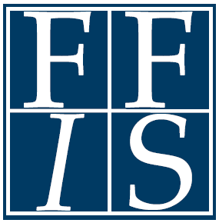
ACA Includes Opportunities for Non-Medicaid Programs, but for How Long?
HSFO Annual Conference
July 30, 2014
Federal Funds Information for States
www.ffis.org

Slide 2
Overview
What are the major funding streams?
How has PPHF benefited states?
How will new ACA coverage affect existing programs?
When do ACA programs expire?
Will they be extended?

Slide 3
But first, ACA funding basics
Includes 100+ funding opportunities of interest to states
Market reform
Medicaid/CHIP
Community-based prevention
Health centers
Health workforce
Long-term care
Maternal and child health

Slide 4
But first, ACA funding basics
ACA created new programs, reauthorized existing ones, and modified uncapped entitlements (Medicaid)
ACA utilized many approaches to fund programs
Direct funding vs. authorized funding
New, flexible special funds
Supplanted annual discretionary appropriations
Various time periods (one-year, multi-year, indefinite)
Most new programs have yet to receive funding
Many programs receiving funding have expired or will soon.

Slide 5
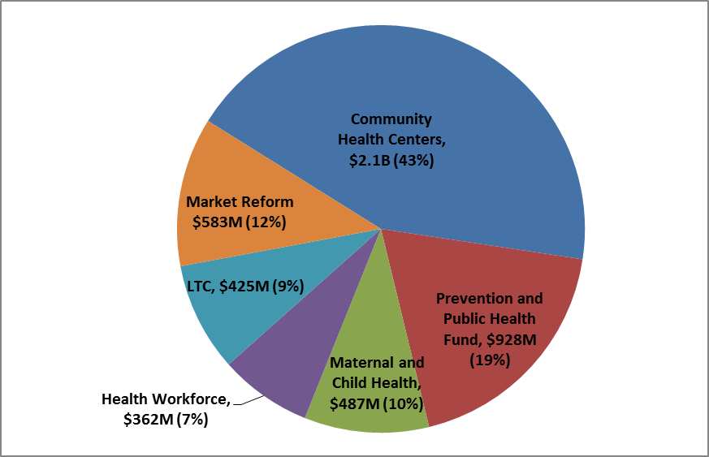
Major ACA non-Medicaid funding streams, FY 2014

Slide 6
Programs receiving an appropriation in ACA
Program | Funding Information | Fiscal Years
Market Reform:
Consumer Assistance Program | $30M | n/a
Rate Review Grants | $250M | 2010-2014
Pre-Existing Condition Insurance Plan | $5B | n/a
Health Insurance Exchange Grants | Secretary determines | Until 12/31/14
Medicaid/CHIP:
Medicaid Adult Health Quality Measures | $60M/year | 2010-2014
Medicaid Emergency Psychiatric Demo. | $75M | 2011 (obligation through 12/2015)
Medicaid Incent. for Prev. of Chronic Diseases | $100M | 2011 (no limit)
Center for Medicare and Medicaid Innovation | $10B | 2011-2019

Slide 7
Programs receiving an appropriation in ACA
Program | Funding Information | Fiscal Years
Medicaid/CHIP:
CHIP childhood obesity demo. | $25M | 2010-2014
CHIP outreach/enrollment | $40M (increase) | through 2015
CHIP annual appropriations | $19B (2014), $21B (2015) | 2014-2015
Medicare:
Outreach and assistance for Medicare low-income individuals (SHIPs, AAA, ADRCs, NCBOE) | $45M | 2010-2012
Environmental health hazards | $23M (2010-2014), $20M (each five year period) | 2010+

Slide 8
Programs receiving an appropriation in ACA
Program | Funding Information | Fiscal Years
Health Centers:
Community Health Centers | $1B-$3.6B/year | 2011-2015
School-Based Health Centers (establishment) | $50M/year | 2010-2013
Health center construction and renovation | $1.5B | 2011-2015
Health Workforce:
Health Profession Opportunity Grant | $80-$85M/year | 2010-2014
Personal and Home Care Aide State Training | $5M/year | 2010-2012
Family-to-Family health information centers | $5M/year | 2010-2012

Slide 9
Programs receiving an appropriation in ACA
Program | Funding Information | Fiscal Years
Community-Based Prevention:
Prevention and Public Health Fund | $500M - $2B/year | 2010+
Maternal and Child Health:
Maternal, Infant, and Early Childhood Home Visiting (MIECHV) | $100M - $400M/year | 2010-2014
Personal Responsibility Education Grant Program (PREP) | $75M/year | 2010-2014
Abstinence Education | $50M/year | 2010-2014
Pregnancy Assistance Fund | $25M/year | 2010-2019

Slide 10
Programs receiving an appropriation in ACA
Program | Funding Information | Fiscal Years
Long-Term Care:
Money Follows the Person | $450M/year | 2012-2016
State Aging and Disability Resource Centers (ADRCs) | $10M/year | 2010-2014
National Background Check Program | $160M | 2010-2012

Slide 11
ACA programs subject to annual appropriations process
Program | Authorized Funding | Funded?
Health Centers:
School-based health centers (operation) | Such Sums As Necessary (SSAN), (2010-2014) | No
Nurse-managed health clinics | $50M (2010), SSAN (2011-2014) | PPHF (2010)
Access to affordable care demo. | SSAN | No
Health Care Workforce:
State health care workforce development grants | Planning: $8M (2010), SSAN; Implementation: $150M (2010), SSAN | PPHF (2010)
Teaching health centers development grants | $25M (2010), $50M (2011-12), SSAN | No

Slide 12
ACA programs subject to annual appropriations process
Program | Authorized Funding | Funded?
Health Care Workforce:
Alternative dental health care provider demo. | SSAN | No (prohibition)
Family nurse practitioner demo. | SSAN (2011-2014) | No
Direct care worker training | $10M (2011-2013) | No
Education and training in pain care | SSAN (2010-2012) | No
Public health workforce loan repayment program | $195M (2010), SSAN (2011-15) | No
Community health worker program | SSAN (2010-2014) | No
Public health and allied health scholarship program | $60M (2010), SSAN (2011-15) | No

Slide 13
ACA programs subject to annual appropriations process
Program | Authorized Funding | Funded?
Health Care Workforce:
Continuing education support for health professionals serving in underserved communities | $5M (2010-14), SSAN | No
Mental and behavioral health education and training | $35M (2010-13) | PPHF (2012)
Community-Based Prevention
Oral health infrastructure | SSAN (2010-14) | No
Community Transformation Grants | SSAN (2010-14) | PPHF (2011-2013)
Community Wellness Pilot | SSAN (2010-14) | No

Slide 14
ACA programs subject to annual appropriations process
Program | Authorized Funding | Funded?
Maternal and Child Health:
Services to individuals with a postpartum condition | $3M (2010), SSAN (2011-12) | No
Other:
Primary care extension program | $120M/year (2011-12), SSAN (2013-14) | No
Regional systems for emergency care | $24M/year (2010-14) | No
Trauma service availability grants | $100M/year (2010-15) | No
Grants to enhance adult protective services | $100M/year (2011-14)
Adult protective services demo grants | $25M/year (2011-14) | PPHF (2012-13)
Liability reform demo. | $50M (2011-15) | No

Slide 15
A detailed look at PPHF
What’s its purpose?
Provide for “expanded and sustained national investment in prevention and public health programs to improve health and help restrain the rate of growth in private and public health care costs”
How much funding is provided?

Slide 16
A detailed look at PPHF
Who determines fund transfers?
Secretary of HHS or House/Senate appropriators
How has the fund been used?
New programs (~29)
Existing programs (~39)
Enhanced funding
Replaced appropriations (in part or entirely)
Federal agencies have relied on grants, contracts, and inter/intra-agency agreements to distribute funds

Slide 17
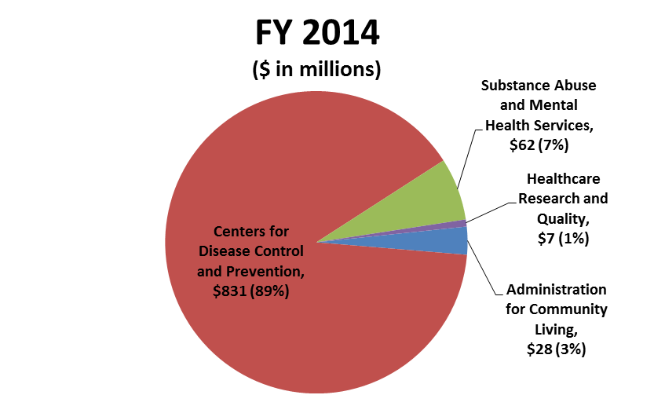
What agencies have received PPHF?

Slide 18
What agencies have received PPHF?

Slide 19
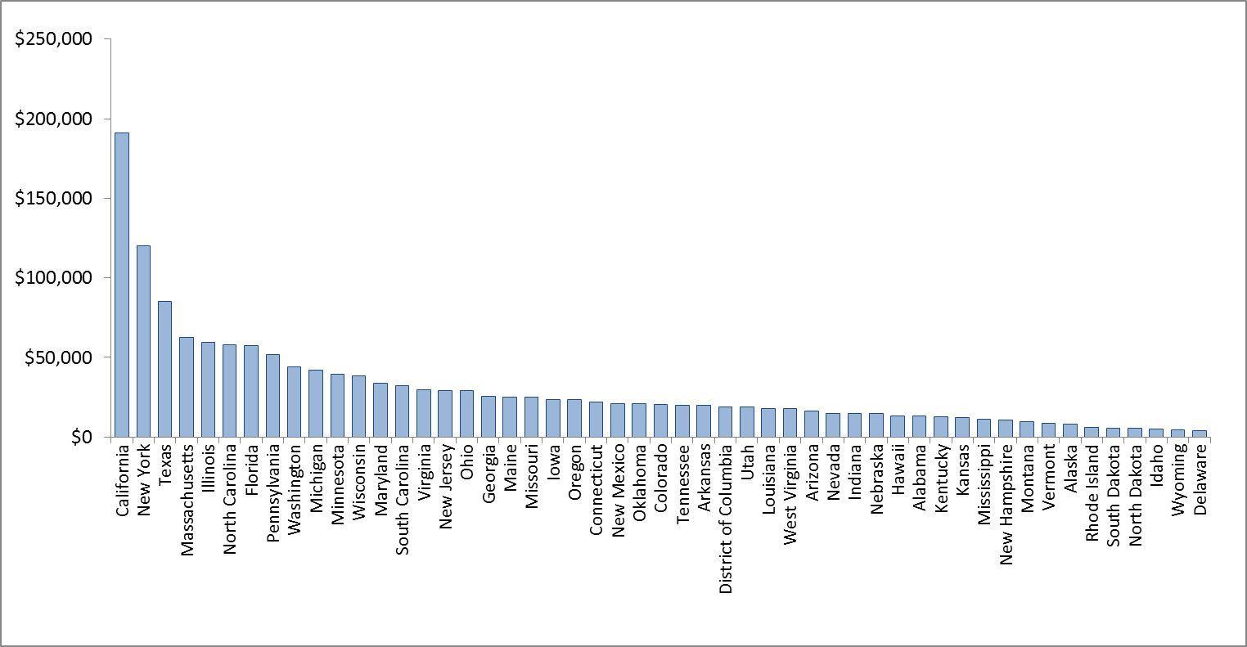
Total state allocations for select PPHF grants, FYs 2010-2013 ($ in thousands)

Slide 20
Risks Facing PPHF
It becomes an offset for legislation or deficit reduction
It continues to supplant existing appropriations
It is used to support federal administration rather than grants

Slide 21
Effect of new ACA coverage on existing programs
Program | FY 2014 ($ in 000’s) | PB 2015 ($ in 000’s) | Percent Change
Access to Recovery | $50,000 | $0 | -100%
Section 317 Immunizations | 588,000 | 536,518 | -9%
National Breast and Cervical Cancer Early Detection | 204,000 | 165,935 | -19%
State High-Risk Pool | 20,420 | 0 | -100%
Refugee Assistance – Transitional and Medical | 391,477 | 383,266 | -2%
Other programs at risk: Ryan White, SABG, MHBG

Slide 22
When do ACA programs/provisions expire?
Already expired
School-based health centers (establishment)
Sept. 30, 2014
Aging and Disability Resource Centers (ADRCs)
January 1, 2015
HHS cannot award additional exchange grants
Rate review grants
Background checks LTC
Personal and Home Care Aide Training
Many discretionary programs

Slide 23
Deadlines on the horizon
April 1, 2015
Medicaid Qualifying Individual and Transitional Medical Assistance*
Sept. 30, 2015
Health Profession Opportunity Grant*
Beyond
PPHF (indefinite)
CMS Innovation Center (9/30/19)
MIECHV*
Medicare Outreach assistance*
Personal Responsibility Education Program*
Abstinence Ed.*
Money Follows the Person (9/30/16)
CHIP
Community Health Centers
Family-to-family*
DSH Cuts (10/1/16)
Pregnancy Assistance Fund (9/30/19)
Notes:
*Most recently extended by Protecting Access to Medicare Act (April 2014)

Slide 24
Outlook
President’s budget did not extend a few programs
Once they expire, many mandatory programs are excluded from baseline
Makes funding more vulnerable
Authorizations for most discretionary programs expire at the end of FY 2014
Long-term program extensions unlikely
Outcome of November elections will play a huge role

Slide 25
Questions?
For more information: www.ffis.org,
Trinity Tomsic (ttomsic@ffis.org )

