Slide 1

Federal Funding Update:
The Craziest Year Yet
Western States Legislative Fiscal Officers Association
September 5, 2012
Federal Funds Information for States

Slide 2
Overview
The Federal Budget Problem
Pieces of the Federal Budget Pie
Congressional “To Do” List
  Before: End of the fiscal year (9/30/12)
  After: The November election (11/7/12)
What Does it Mean for States?

Slide 3
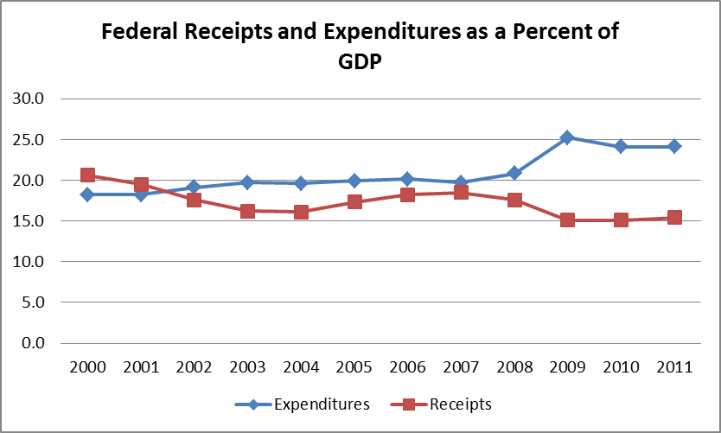
The Federal Budget Problem

Slide 4
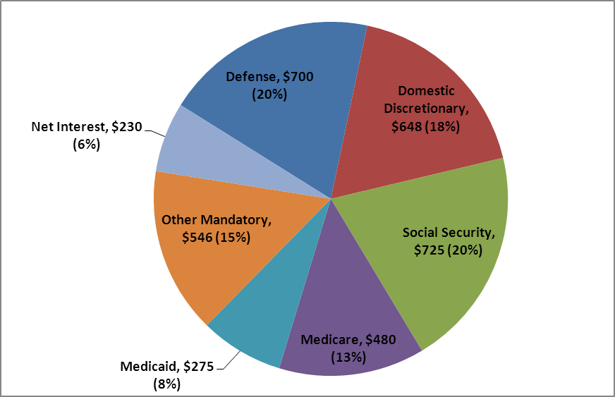
Where the Money Goes:
Pieces of the Federal Budget Pie
Composition of Federal Outlays in FY 2011
($ in Billions, % of Total)

Slide 5
Federal Grant Money that Goes to
State and Local Governments

Slide 6
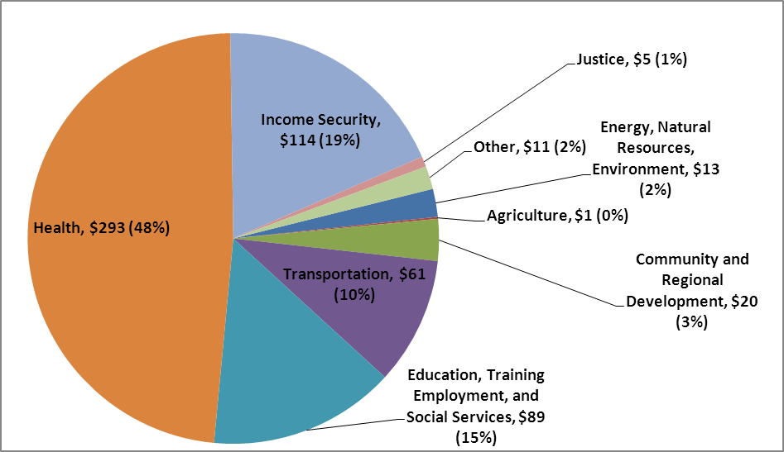
State/Local Grants by Program Area
Federal Outlays to State and Local Governments, FY 2011
($ in Billions, % of Total)

Slide 7
Federal Revenue as a Percent of State and Local General Revenue, FY 2010

Slide 8
“Must Do” List before Sept. 30, 2012
Enact FY 2013 budget or pass a Continuing Resolution (CR)
Authorize or extend Farm Bill
Authorize or extend TANF

Slide 9
FY 2013 Appropriations:
A $19 Billion Difference
FY 2013 302(b) Allocations
(in billions)
 | FY 2013 Funding Levels |  |  | Senate v. House
Appropriations Bills | House | Senate |  | Dollars | Percent
Agriculture | $19.4 | $20.8 |  | $1.4 | 6.6%
Commerce-Justice-Science | 51.1 | 51.9 |  | 0.7 | 1.4%
Defense | 519.2 | 511.2 |  | -8.1 | -1.6%
Energy-Water Development | 32.1 | 33.4 |  | 1.3 | 3.8%
Financial Services-General Government | 21.2 | 23.0 |  | 1.8 | 8.0%
Homeland Security | 39.1 | 39.5 |  | 0.4 | 1.0%
Interior-Environment | 28.0 | 29.7 |  | 1.7 | 5.6%
Labor-Health and Human Services-Education | 150.0 | 157.7 |  | 7.7 | 4.9%
Legislative Branch | 4.3 | 4.4 |  | 0.1 | 3.0%
Military Construction-Veterans Affairs | 71.7 | 72.2 |  | 0.5 | 0.7%
State-Foreign Operations | 40.1 | 49.8 |  | 9.7 | 19.5%
Transportation-Housing and Urban Development | 51.6 | 53.4 |  | 1.8 | 3.4%
Total Discretionary Spending | $1,027.9 | $1,047.0 |  | $19.1 | 1.8%

Slide 10
Status of FY 2013 Appropriations

Slide 11
FY 2013 Appropriations:
At What Cost to States?
 |  | Proposed FY 2013 vs. FY 2012
Federal Agency | FY 2012 vs. FY 2010 | President | House | Senate
Education | -1.1% | 1.3% | n/a | 0.5%
Health and Human Services | -5.6% | -1.9% | n/a | 1.2%
Housing and Urban Development | -5.4% | 1.7% | 2.4% | 5.2%
Energy/EPA | -33.2% | -11.6% | -36.2% | n/a
Justice | -40.9% | -1.5% | -6.0% | 6.9%
Homeland Security | -35.4% | 29.4% | 27.2% | 3.5%
Labor | -4.9% | -2.2% | n/a | -2.9%
Transportation | -9.0% | 6.8% | -0.3% | 0.3%

Slide 12
FY 2013 Appropriations:
Potential Funding Increases
Special Education
Ryan White AIDS Grants
Head Start
Child Care Development Block Grant
Community Development Block Grant
Housing programs
Byrne JAG

Slide 13
FY 2013 Appropriations:
Potential Funding Decreases
Economic Development Assistance
Race to the Top
Hospital Preparedness
Family Planning
State Energy Program
Clean Water and Drinking Water SRF
Juvenile Accountability Block Grant
UI State Administration

Slide 14
Will Congress Pass a FY 2013 Budget?
CR likely, but for how long?
  House and Senate leaders reached broad agreement on six-month CR.
  Details not yet known.
  Will it pass both houses in September?
  What happens after March 30, 2013?

Slide 15
Will Congress Reauthorize or Extend Expiring Programs?
TANF and Related Programs
  No movement on reauthorization bill
  Each extension includes new requirements
  New waiver policy could affect next extension
Farm Bill
  Full Senate, House committee have approved reauthorization bill
  Bipartisan bill possible but differences remain

Slide 16
2012 Farm Bill:
Key Provisions Affecting States
SNAP funding reductions
(-$4b in Senate vs. -$16b in House)
  Both include eligibility changes; House goes further by limiting categorical eligibility to cash assistance.
  House eliminates state performance bonuses, reduces funding for employment and training.
  Both increase threshold level for reporting SNAP errors.
Increased funding for TEFAP, formula change for Specialty Crop Block Grant

Slide 17
“To Do” List for Lame Duck Congress
Address the BCA’s looming sequester
Deal with expiring tax provisions
Consider other expiring legislation, authorizations
Raise the debt limit
Reassure markets and American consumers

Slide 18
CBO Estimates of the Fiscal Cliff

Slide 19
The BCA and Looming Sequester
Absent a legislated alternative, a sequester will occur in January 2013
$984 billion in cuts required over FYs 2013-2021 (roughly $109 billion per year, half from defense and half from nondefense)
Many mandatory and a few discretionary programs are exempt
ATB cuts in FY 2013, different process for FY 2014+

Slide 20
Sequester: What We Don’t Know
What is the ATB percentage cut?
CBO estimates 7.8% for nondefense discretionary and mandatory, 10% for defense
Exact percentage won’t be known until
January 2013 (will depend on base subject to sequester)

Slide 21
Sequester: What We Don’t Know
How will individual programs be affected?
Percentage reduction applied to FY 2013 funding (or CR level)
OMB has authority to apply exemptions and special rules
  Federal law lists programs and activities exempt from sequester (each item identified by budget account)
  Federal law establishes special rules for certain programs

Slide 22
Sequester: What We Don’t Know
How much discretion do agencies have in implementing sequester?
Virtually none
Some influence over timing (recent ED guidance)
Will Congress and the president modify the BCA?
Various proposals, no agreement (explicit legislation required)
Congress did pass legislation requiring OMB to provide sequester details

Slide 23
Examples:
Major Exemptions and Special Rules
Provision/Program | Notes
Payments to trust funds from excise taxes or other receipts are exempt. | Programs that appear to fall under this exemption include: Abandoned Mine payments, Boating Safety, Crime Victims Fund, Sport Fish Restoration, Wildlife Restoration, and Hunter Safety.
Nondefense unobligated balances carried over from previous fiscal years are exempt. | In general, funding included in the Affordable Care Act (ACA) is not exempt from sequester unless provided to an exempt program, such as Medicaid, or appropriated in a prior fiscal year and still available for obligation.

Slide 24
Examples:
Major Exemptions and Special Rules
Provision/Program | Notes
Medicare, community and migrant health centers, and Indian health services are limited to 2% cuts. | Since total funding for Medicare is projected to increase each year (and thus the 2% sequester amount borne by Medicare), cuts to nonexempt, nondefense programs would fall over time. The Qualified Individuals (QI) program in which states receive reimbursement for paying Medicare Part B premiums for certain individuals is exempt. Medicare Part D low-income subsidies and the Part D catastrophic subsidy are also exempt. The 2% limit for Community Health Centers applies to discretionary appropriations. Community Health Centers also receives a direct appropriation (mandatory funds) from ACA. It is unclear whether OMB will apply the 2% limit to this funding. Both funding streams are included under the same budget account.

Slide 25
Examples:
Major Exemptions and Special Rules
Provision/Program | Notes
The treatment of unemployment insurance (UI) varies by component. | Regular unemployment compensation (UC) benefits and loans to states to cover UC payments are exempt. However, state administration and the federal share of the permanently authorized extended benefit program are not. In addition, the Emergency Unemployment Compensation (EUC) program is subject to sequester, although the authorization for this program expires at the beginning of calendar year 2013.

Slide 26
Examples:
Major Exemptions and Special Rules
Provision/Program | Notes
Funds for programs funded through revolving, trust, and special fund accounts are still subject to sequester and would not be available for obligation in FY 2013. However, the sequestered FY 2013 funds would become available at the end of the sequestration period (October 1, 2013). | Program examples include Mineral Leasing Payments, Bureau of Land Management’s Payments in Lieu of Taxes program, Coastal Impact Assistance, and Forest Service – National Forests.

Slide 27
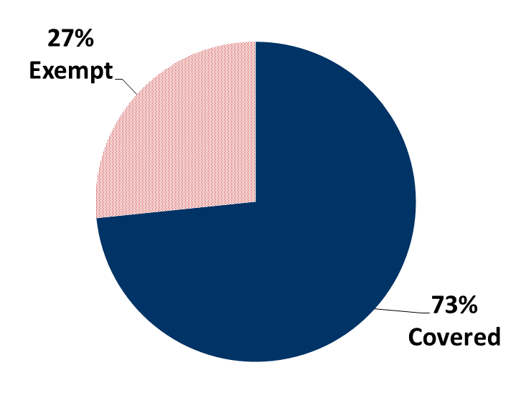
Sequester Coverage Status of FFIS-Tracked Programs

Slide 28
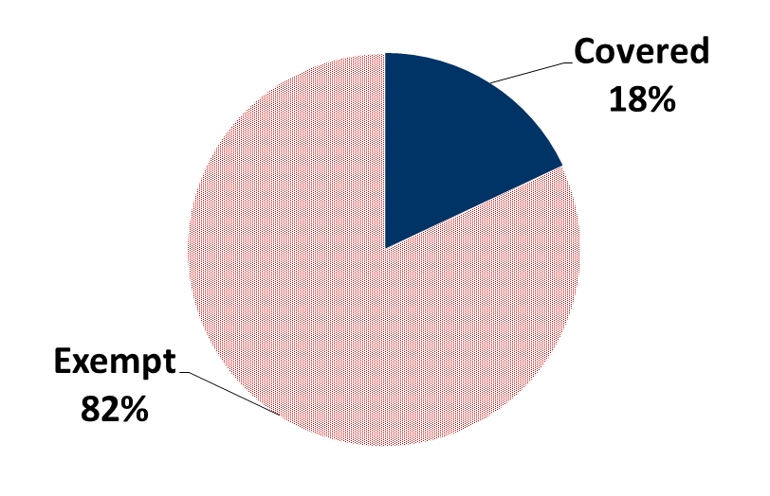
Sequester Coverage Status of FFIS-Tracked Funding

Slide 29
Program Areas Most Affected
Budget Function | % of Funding Covered by Sequester
Agriculture | 100%
Employment and Training | 100%
Community Development | 90%
General Gov’t | 85%
Energy, Env., Natural Resources | 78%
Justice | 62%
Education | 54%
Income Security and Social Services | 23%
Health | 4%
Transportation | 4%

Slide 30
What We Can Guess About a Sequester
Potential Impact of BCA Sequester (in millions)
 | FY 2010 | FY 2011 | FY 2012 | FY 2013
Nondefense Grants:
Covered Programs | N/A | $109,539 | $106,682 | $98,815
Dollar Change |  |  | -2,857 | -7,867
Percent Change |  |  | -2.6% | -7.4%
NIH Funding:
Total | N/A | 23,753 | N/A | 21,900
Dollar Change |  |  |  | -1,853
Percent Change |  |  |  | -7.8%
Defense Funding:
Total | 508,490 | N/A | N/A | 457,641
Dollar Change |  |  |  | -50,849
Percent Change |  |  |  | -10.0%

Slide 31
Expiring Tax Provisions
Bush-era tax cuts (~$110b in FY 2013)
  Personal income, dividends, capital gains, and estates
  Child tax credit and other refundable tax credits
  Personal exemptions and itemized deductions for upper-income individuals
  Provisions to reverse the marriage penalty
2 percentage-point payroll tax reduction (~$90b)
AMT “fix” (~$125b)

Slide 32
Supplemental Unemployment Benefits
Emergency Unemployment Compensation (EUC)
  Expires January 2, 2013
  The Middle Class Tax Relief and Job Creation Act of 2012 (P.L. 112-96) eliminated the phase-out period, so all benefits terminate
Extended Benefits (EB)
  100% federal financing expires December 31, 2012
  Phase out expires June 30, 2013
  Three-year look-back expires December 31, 2012

Slide 33
Other Programs/Provisions Expiring on December 31, 2012
Medicaid – Qualifying Individual (QI) Program
Transitional Medical Assistance (TMA)
“Doc Fix” that prohibits 30% decrease in reimbursements rates to Medicare providers
Will TANF and the Farm Bill be extended to December 31, 2012?

Slide 34
Markets and Consumers
Last year’s efforts to raise the debt limit, (which resulted in the BCA), spooked markets, led to debt rating downgrade and sent consumers and employers running for cover.
Are we in for a repeat?

Slide 35
What’s the Conventional Wisdom?
For appropriations, a CR, BUT…
For BCA, agreeing to postpone the day of reckoning, BUT…
For expiring tax provisions, a bruising fight, informed by the election.
For authorizations, probably extensions, BUT...

Slide 36
What Does this Mean for States?
If Congress Goes for It…..
“Grand Bargain” means greater certainty but less funding. Likely changes include:
  Reforms to entitlement programs (flexibility vs. funding)
  Further reductions in discretionary spending
  Revenue effects from tax overhaul, and potential loss of state-focused tax expenditures

Slide 37
What Does this Mean for States?
If Congress Punts…..
States continue to face uncertainty
FY 2013 budget won’t happen anytime soon
  President’s FY 2014 budget released before FY 2013 budget is finalized
Program extensions continue
In short, more of the same

Slide 38

The End: Questions?
Contact information: Trinity Tomsic
202-624-8577, ttomsic@ffis.org

